Slide 1

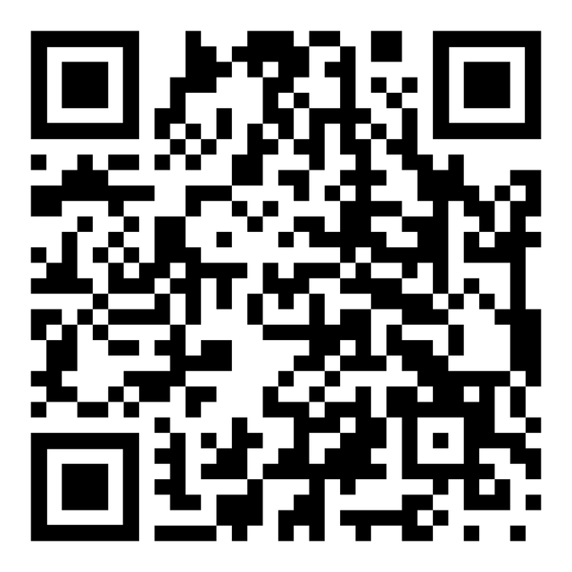
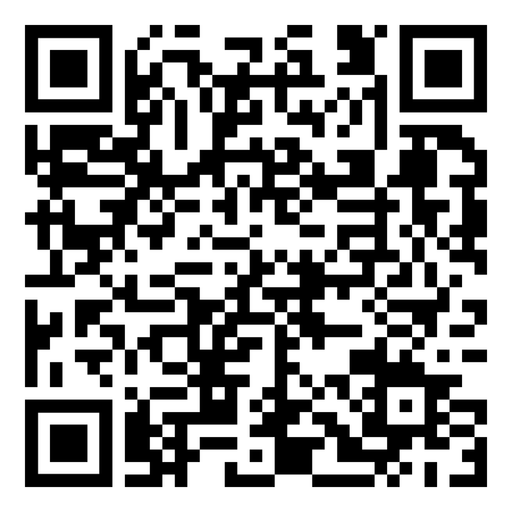
VolleyStation Score
Thank you for helping us roll out the new way to score. VS score is an app designed to make scoring easier. See the 3 pages on the desk for help and tips
1.Please put your phone on do not disturb
2. The app replaces the libero tracker as well. have the libero tracker sit next to you and help call out the libero entries and subs
3. Enjoy!
---DOWNLOAD---
APPLE APP STORE
GOOGLE PLAY

Slide 2


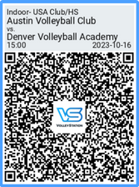
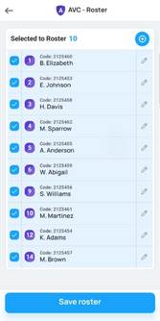
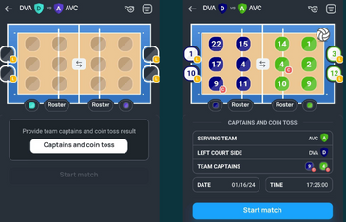


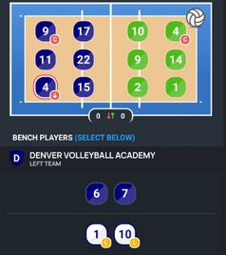
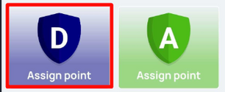
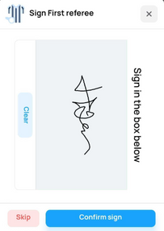
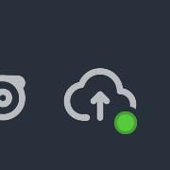
Quick Start Guide
STEP BY STEP
PREMATCH
  download - open - tap try app
  tap blue circle on bottom
  select [Scan QR CoDE]
  referee will give you QR CODE
  confirm rosters
  set lineups & liberos
  change colors and sides
  SET Captains & coin toss
  start match
  put liberos in!!!
  tap serve
  assign point
  subs - tap the number going out then the number going in
  app will guide you
  at the end hit the signature buttons for scorer and referee
DURING THE MATCH
END OF MATCH
hit these buttons
subs
hit signatures
libero in and out
sign
confirm data is flowing
with green dot
they work the same - tap the number going out - tap the number going in

Slide 3


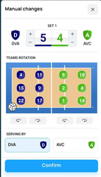
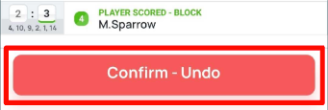
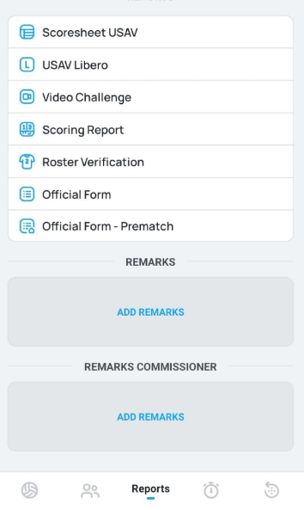
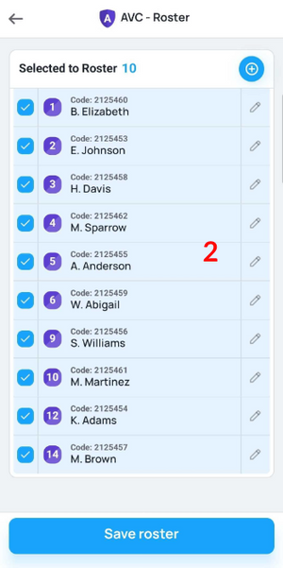
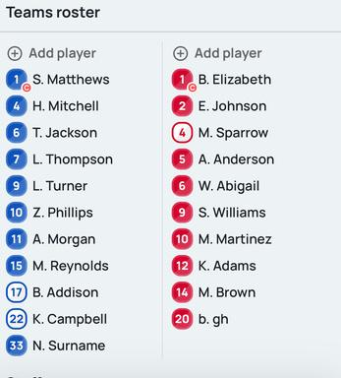



FAQS
REFEREE CHANGES CALL OR I MESSED UP
I REALLY MESSED UP
tap the score to open manual changes
change what you need to
PHONE DIED
SEE SCORESHEET
get another phone
rescan qr code from ref
hit continue match
ADD/EDIT PLAYER - PREMATCH
ADD PLAYER - DURING
click on the roster icon
ADD
edit
someone is number ZERO - just change to 99 or 88
hit ADD PLAYER
*ONLY HAVE TO ENter shirt number during the match
TEAMS AREN’T POPULATED
EXCEPTIONAL SUB / INJURY
CARDS
APP CRASHES
don’t panic
data is saved
just reopen the app
wait 3-5 minutes
the oompa loompas
are working on it
follow the prompts

