Slide 1
VolleyStation Score

Slide 2
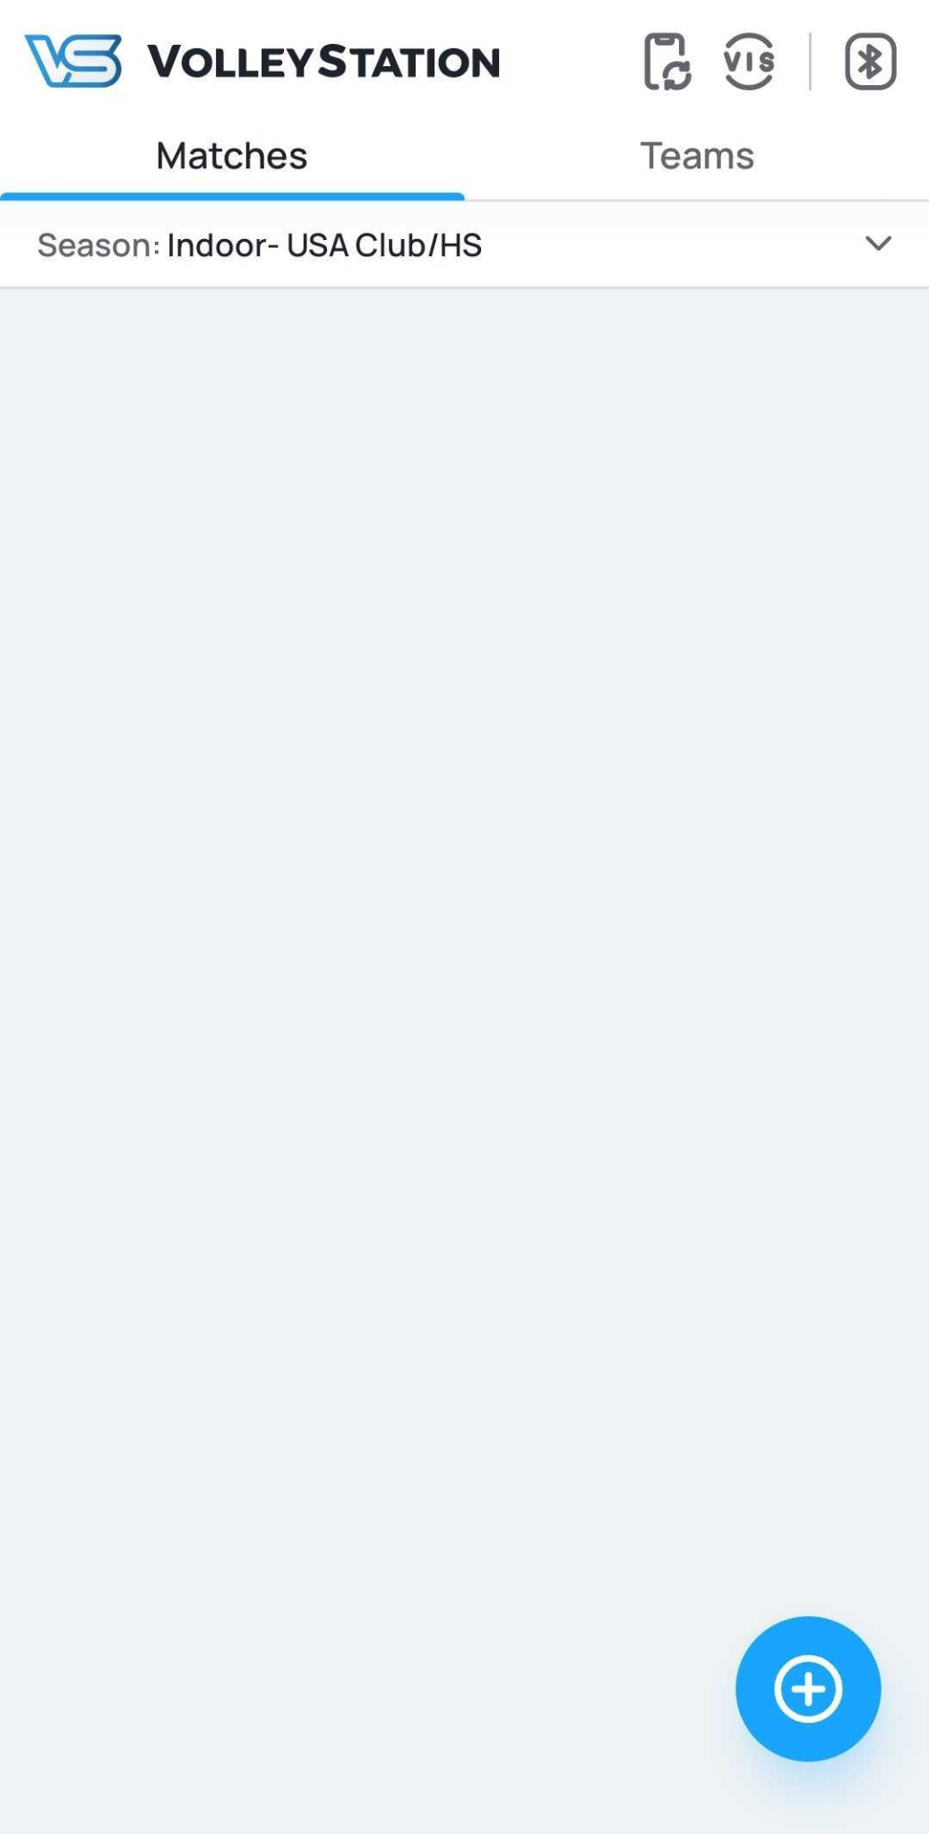
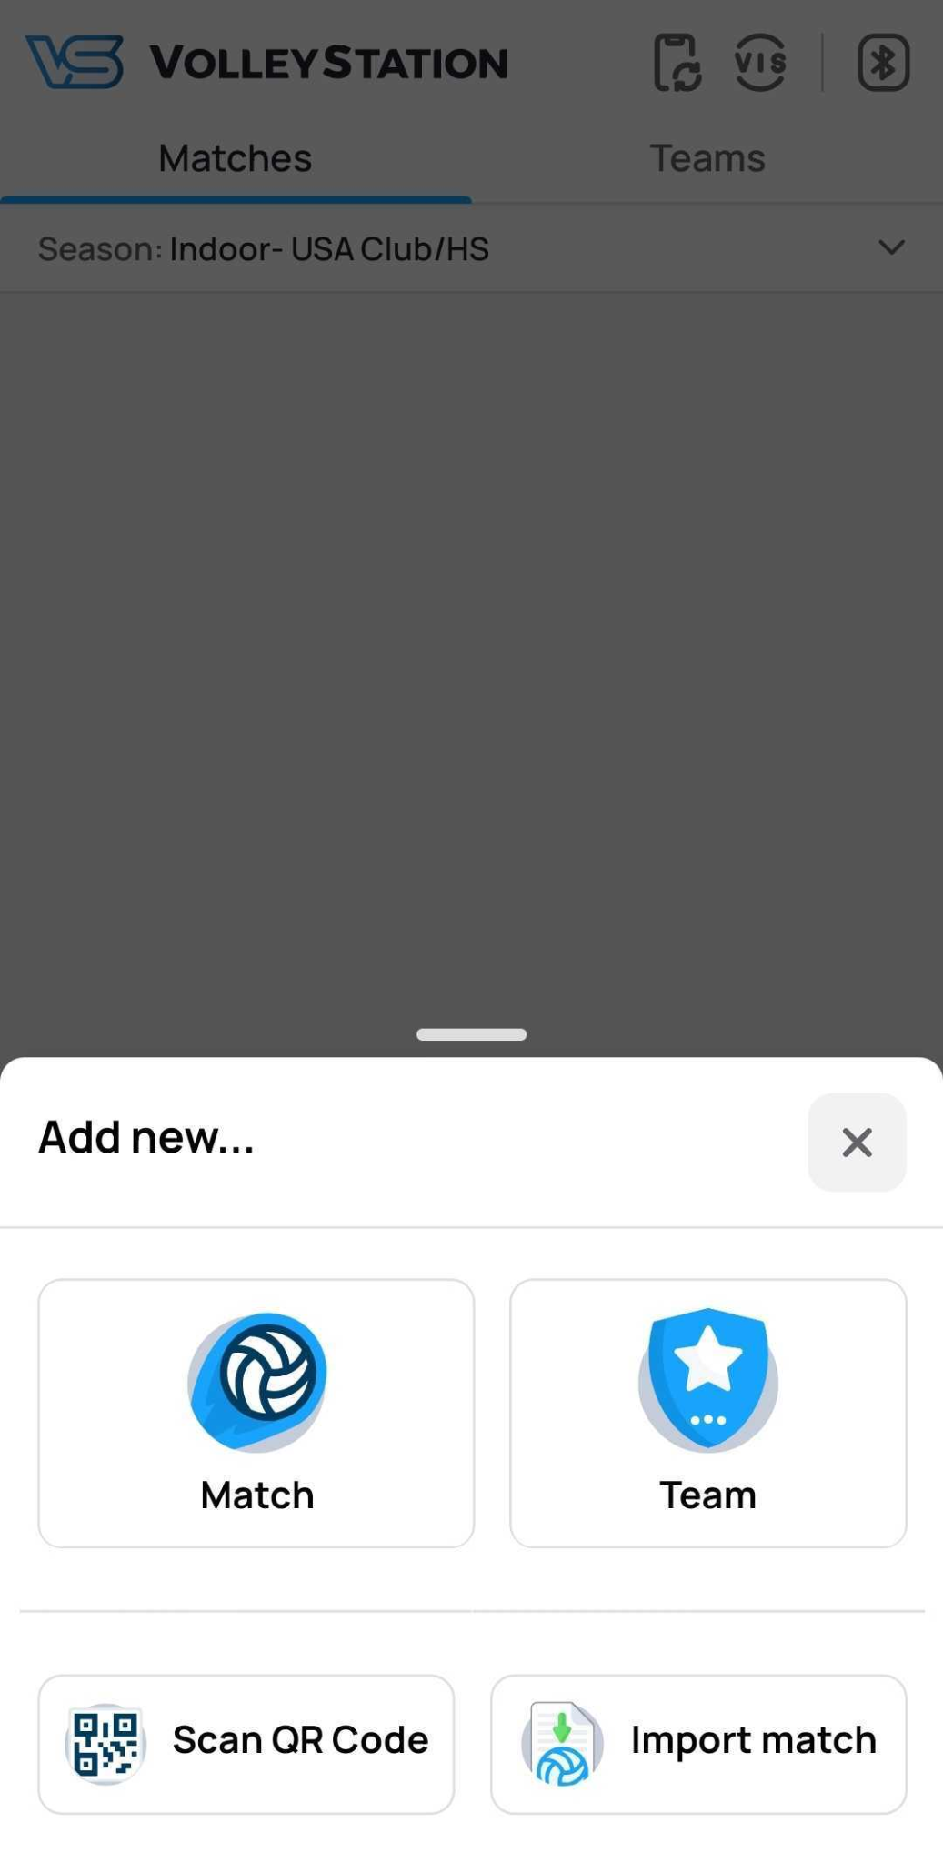
Opening new match
To open a new match:
Press “+” sign in the bottom right corner
Select “Match”
1

Slide 3
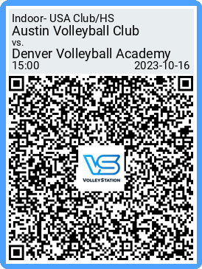
Opening new match
To open a new match:
Press “+” sign in the bottom right corner
Select “Scan QR code”
Scan QR code provided by the referee/ tournament organizer
Match information window with pre-filled data will appear

Slide 4
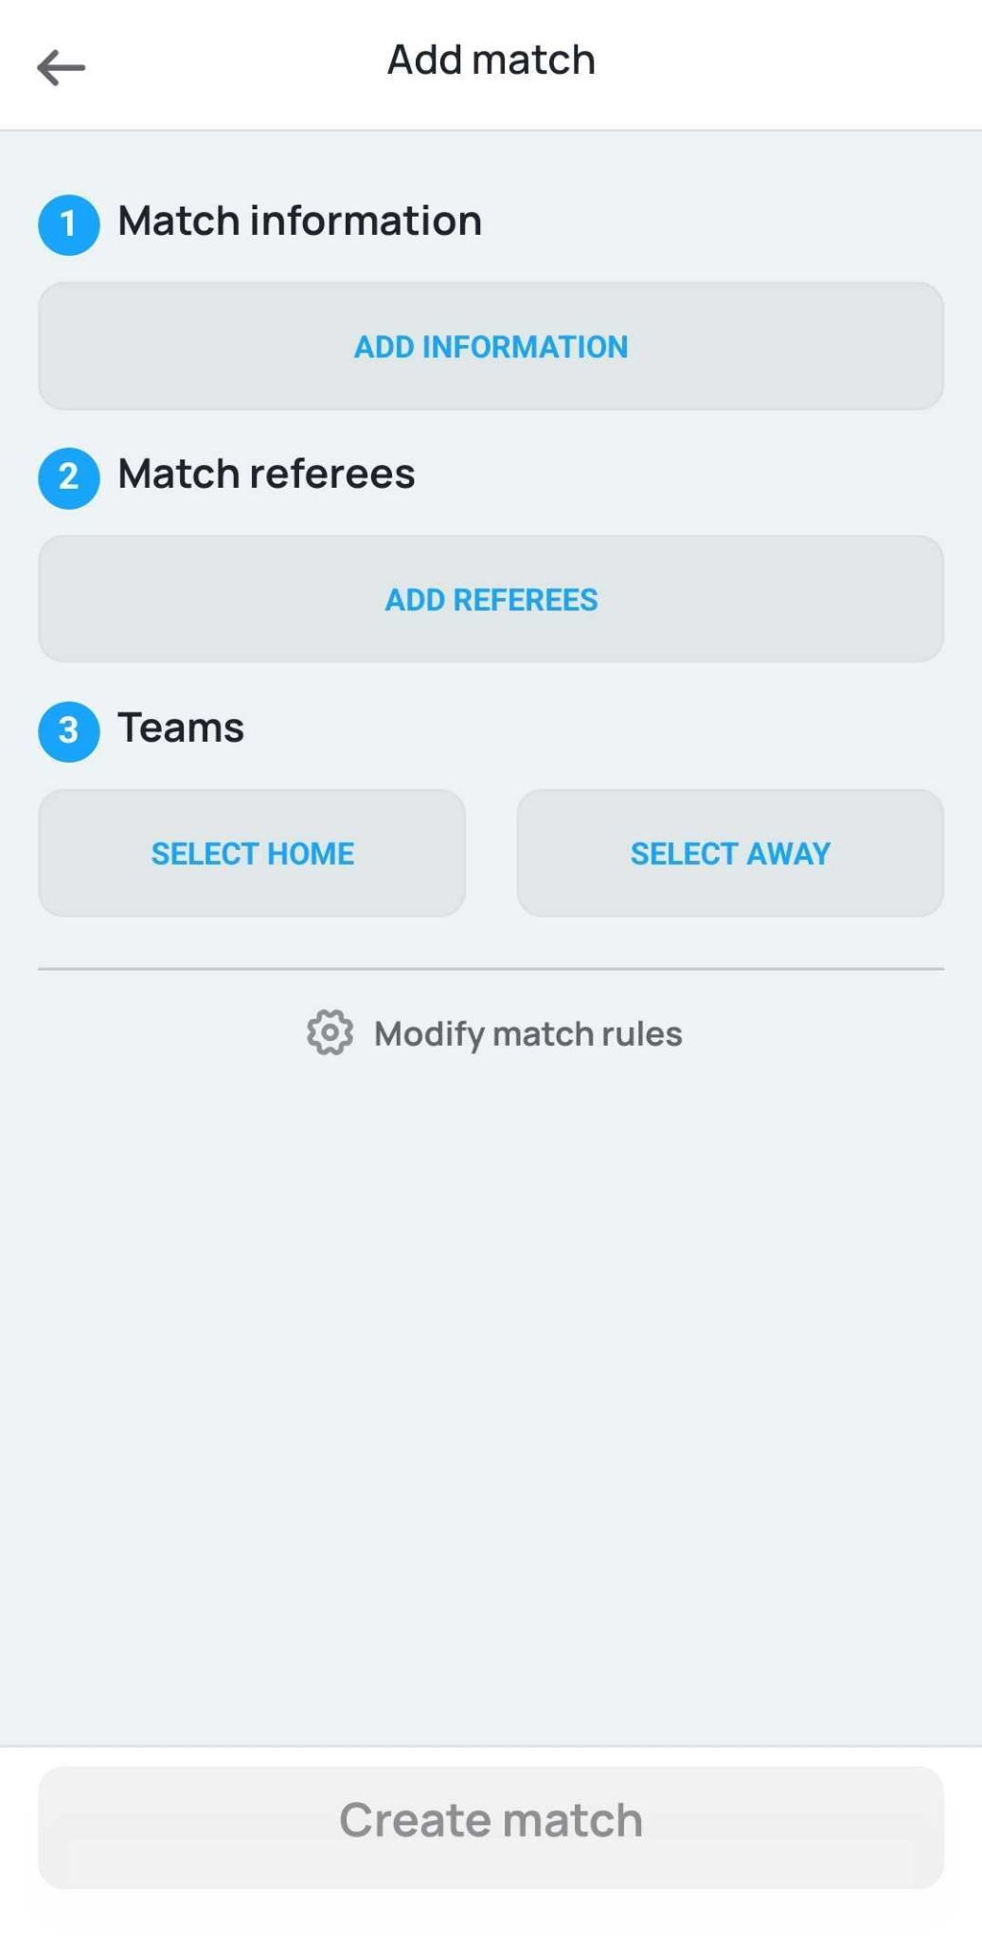
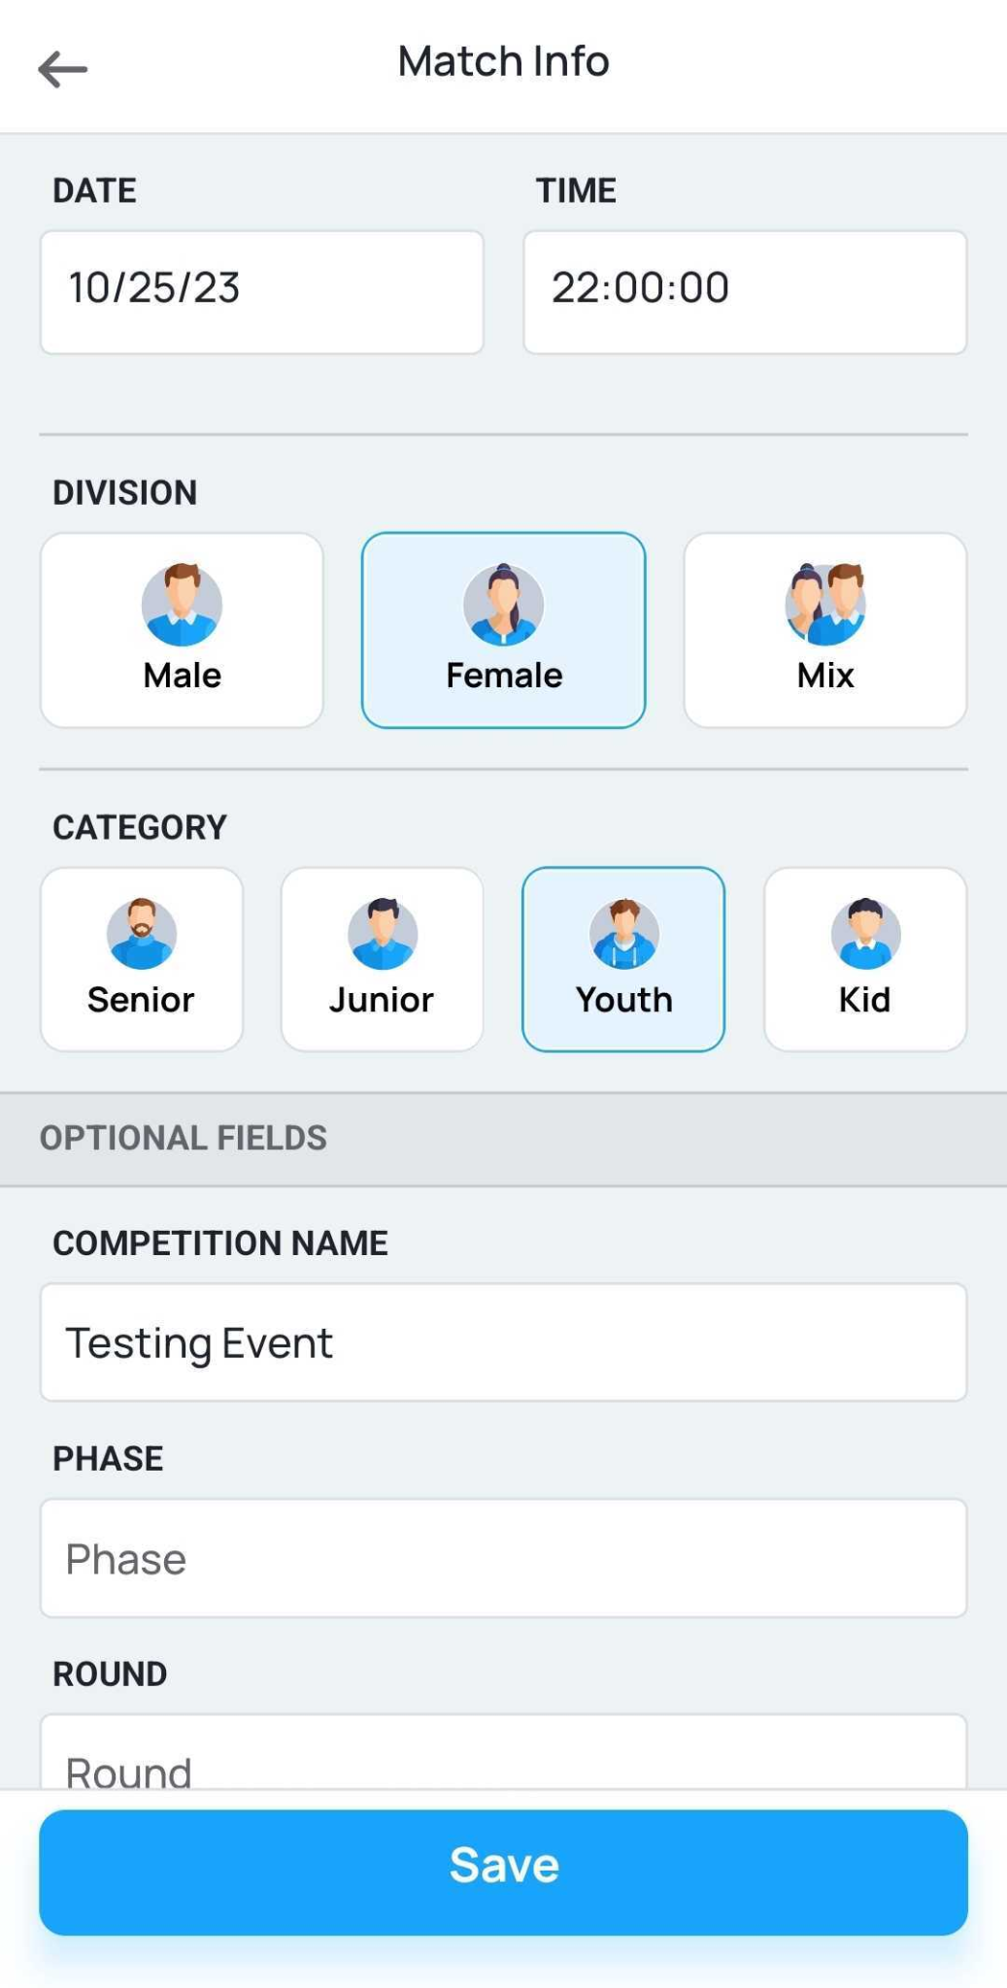
Match information
While creating the match you will need to fill or select following information:
Match information
Match referees
Teams
Modify match rules
Please note that steps 1. and 3. are mandatory in order to create the match

Slide 5
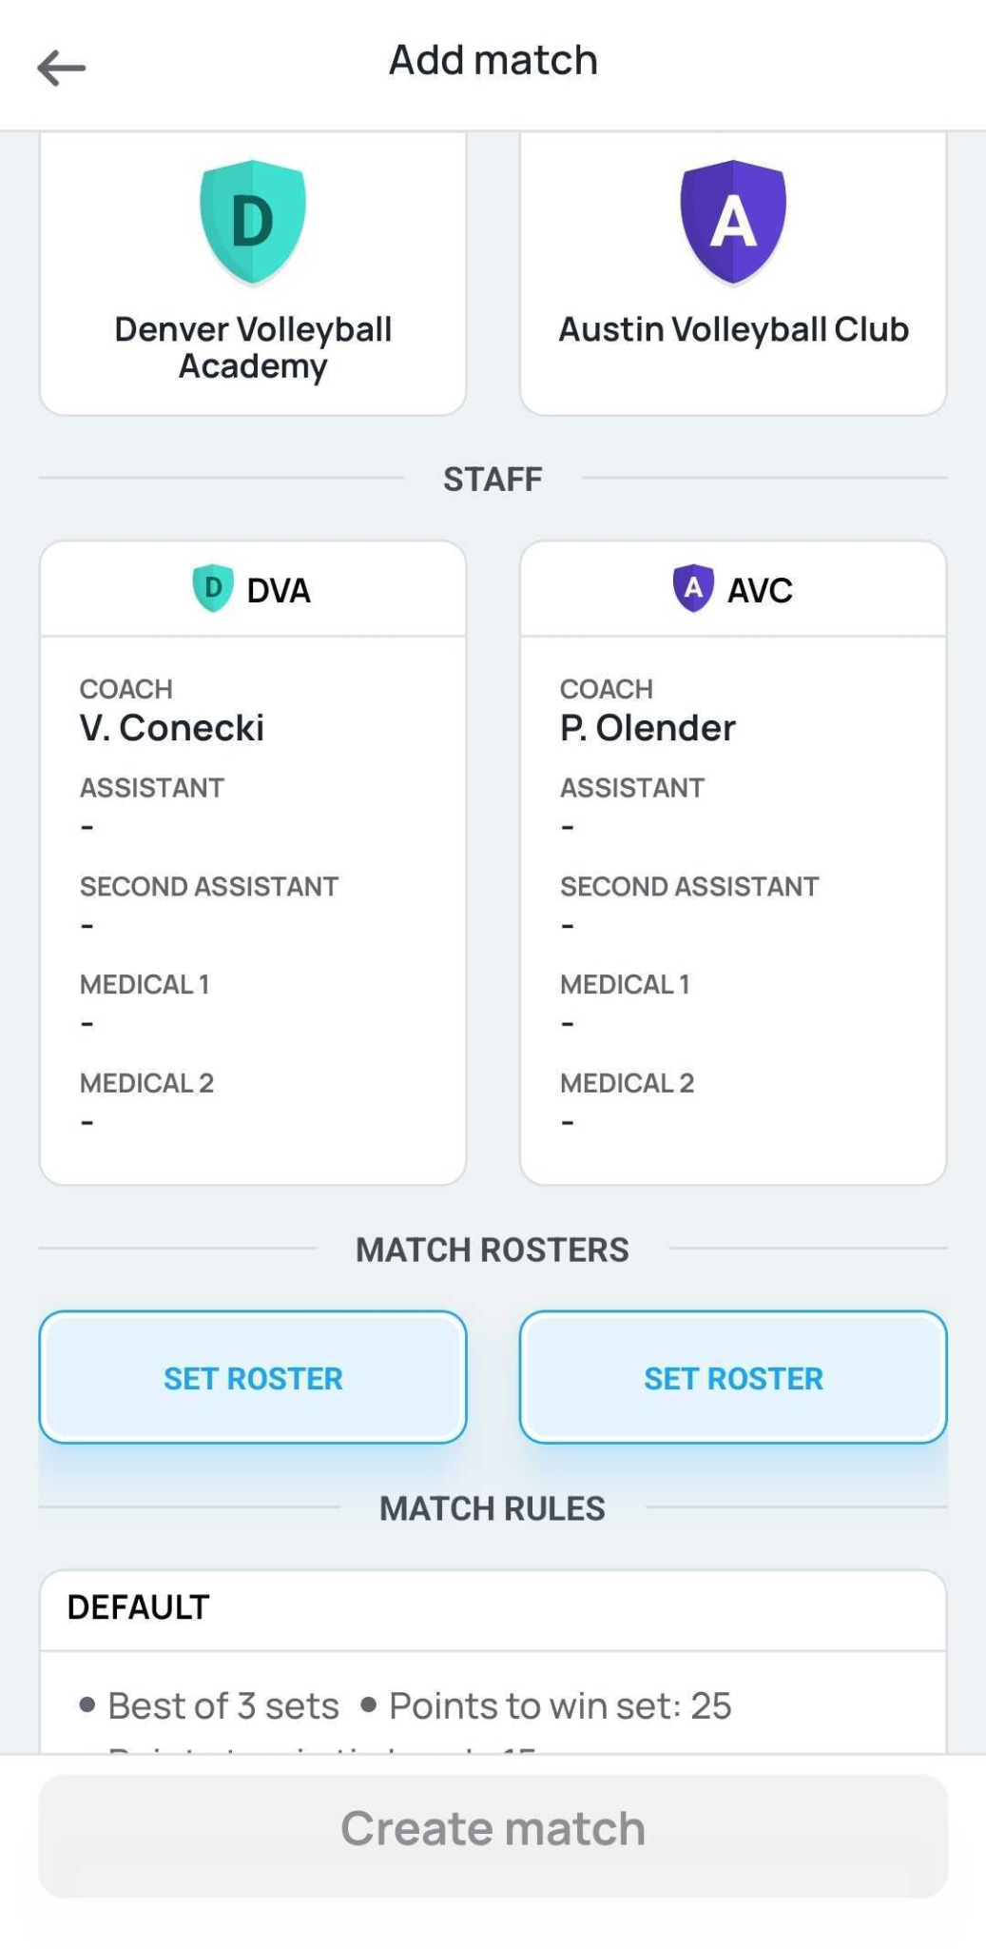
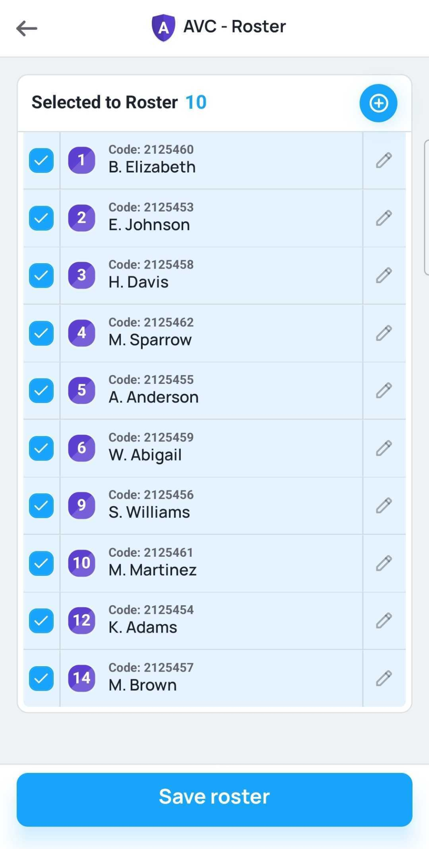
Setting the team roster and creating match
In order to select players for the match select “SET ROSTER”
Confirm that all selected players have the right numbers and will be attending the match
Once all information will be available* create the match
*In case you are not able to press “Create match” button, please check if all the steps mentioned above were completed
2
1
3

Slide 6
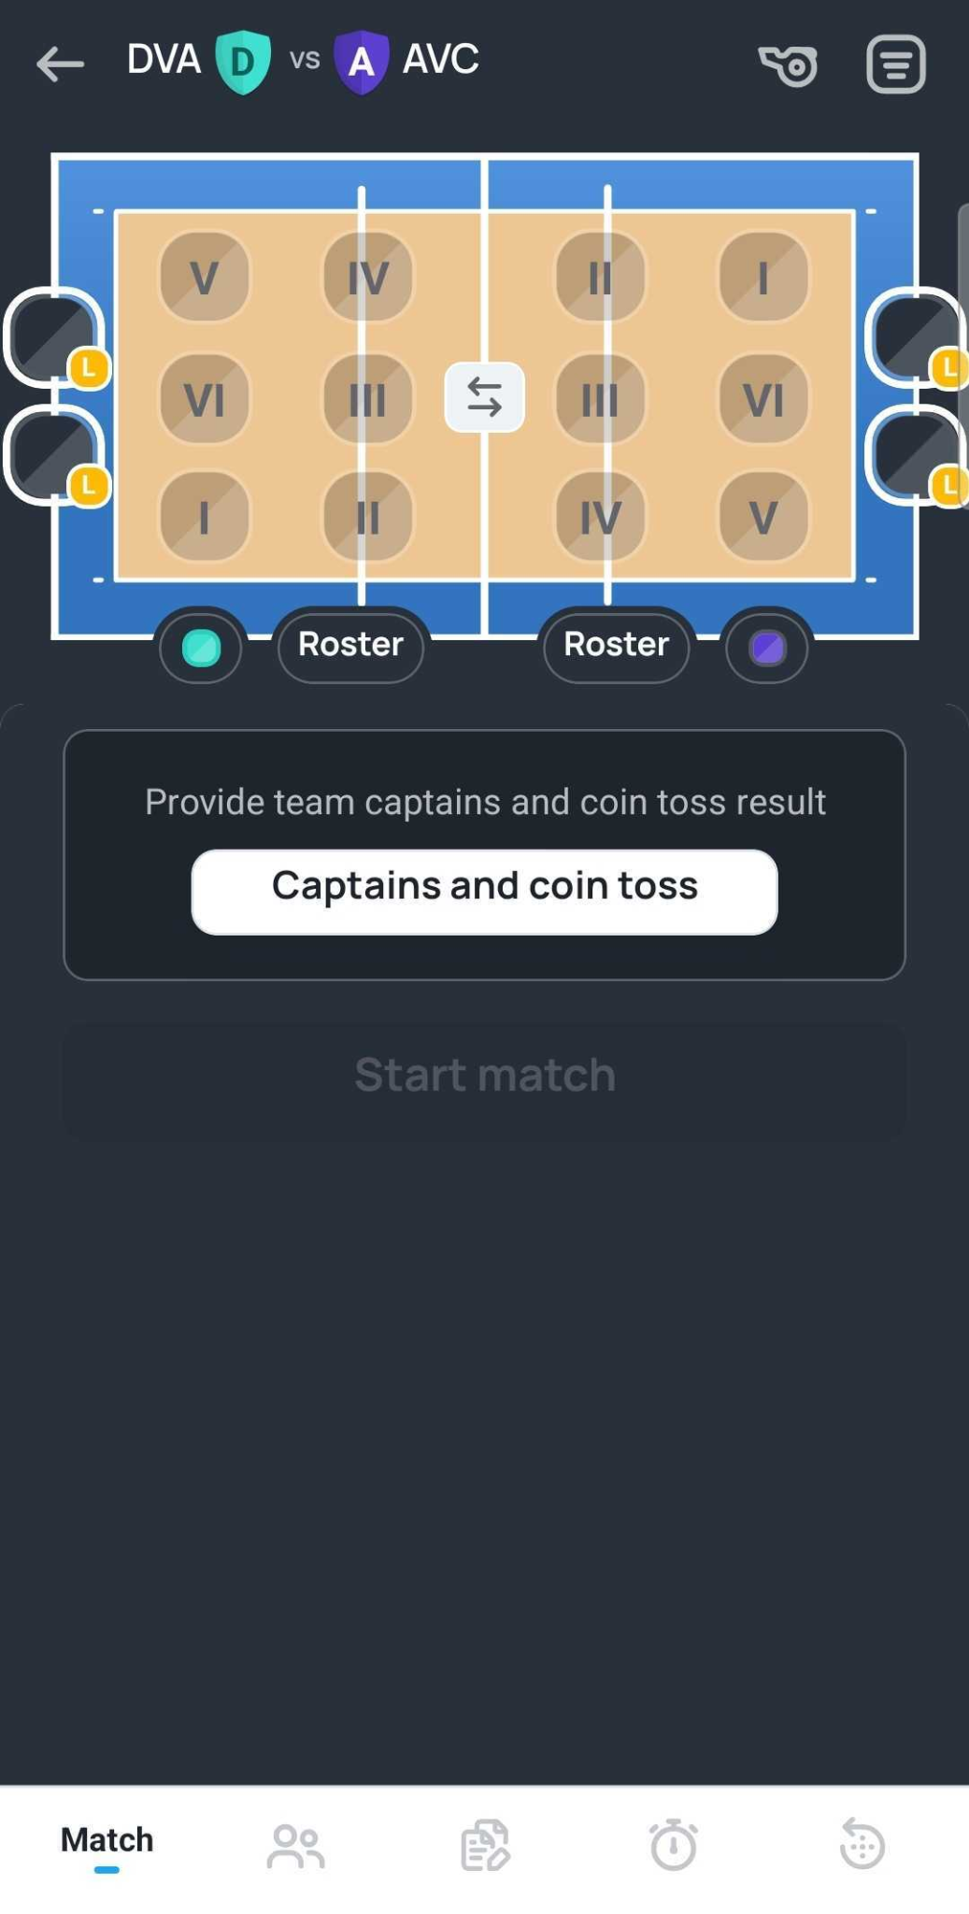
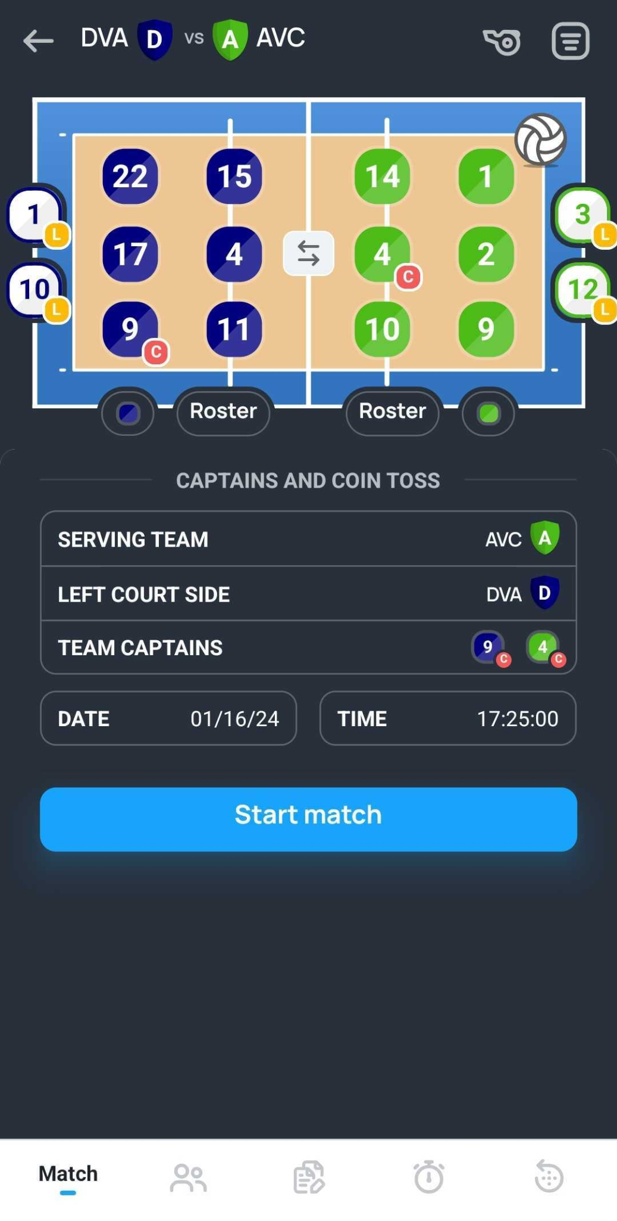
Lineup Selection and Coin Toss
Once the match is created you are able to select:
Team colors
Lineup*
Captains
Coin toss outcome. After its concluded determine
Winner of the coin toss
Serving team
Swap team sides if necessary
*To select lineup, assign player to the relevant court zone.

Slide 7
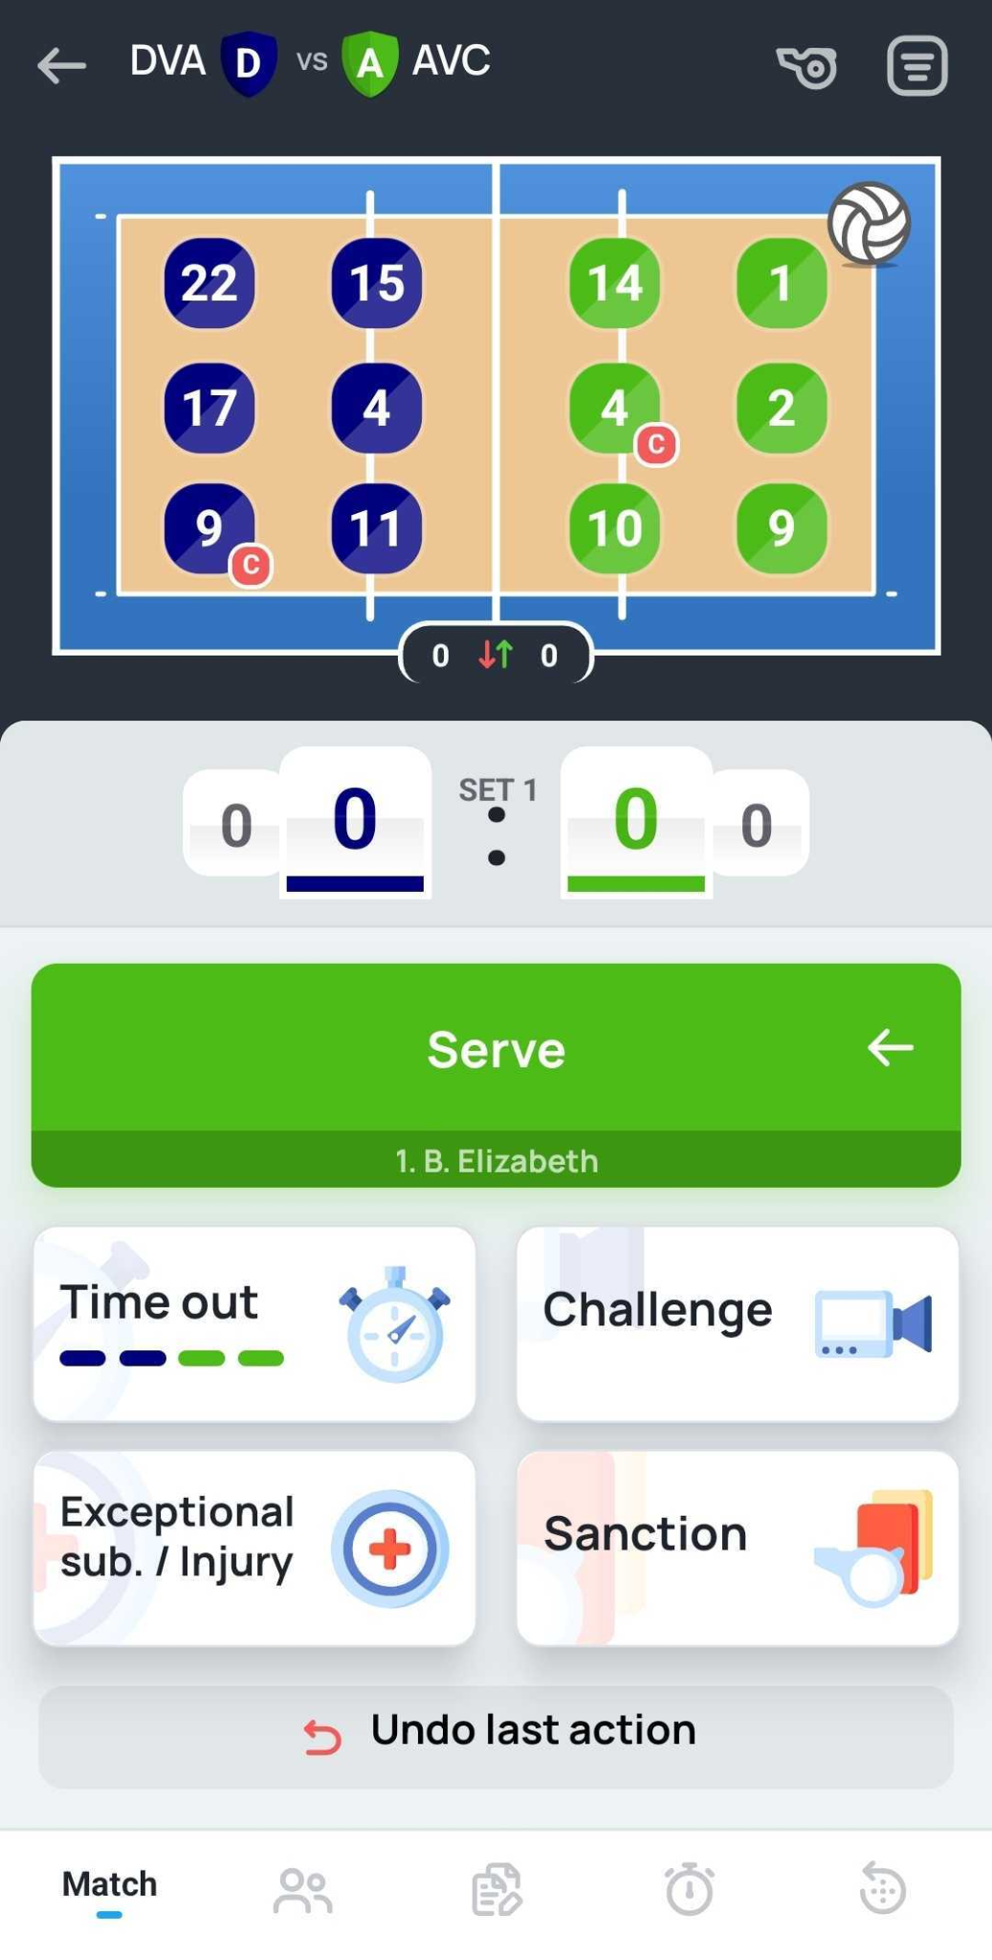
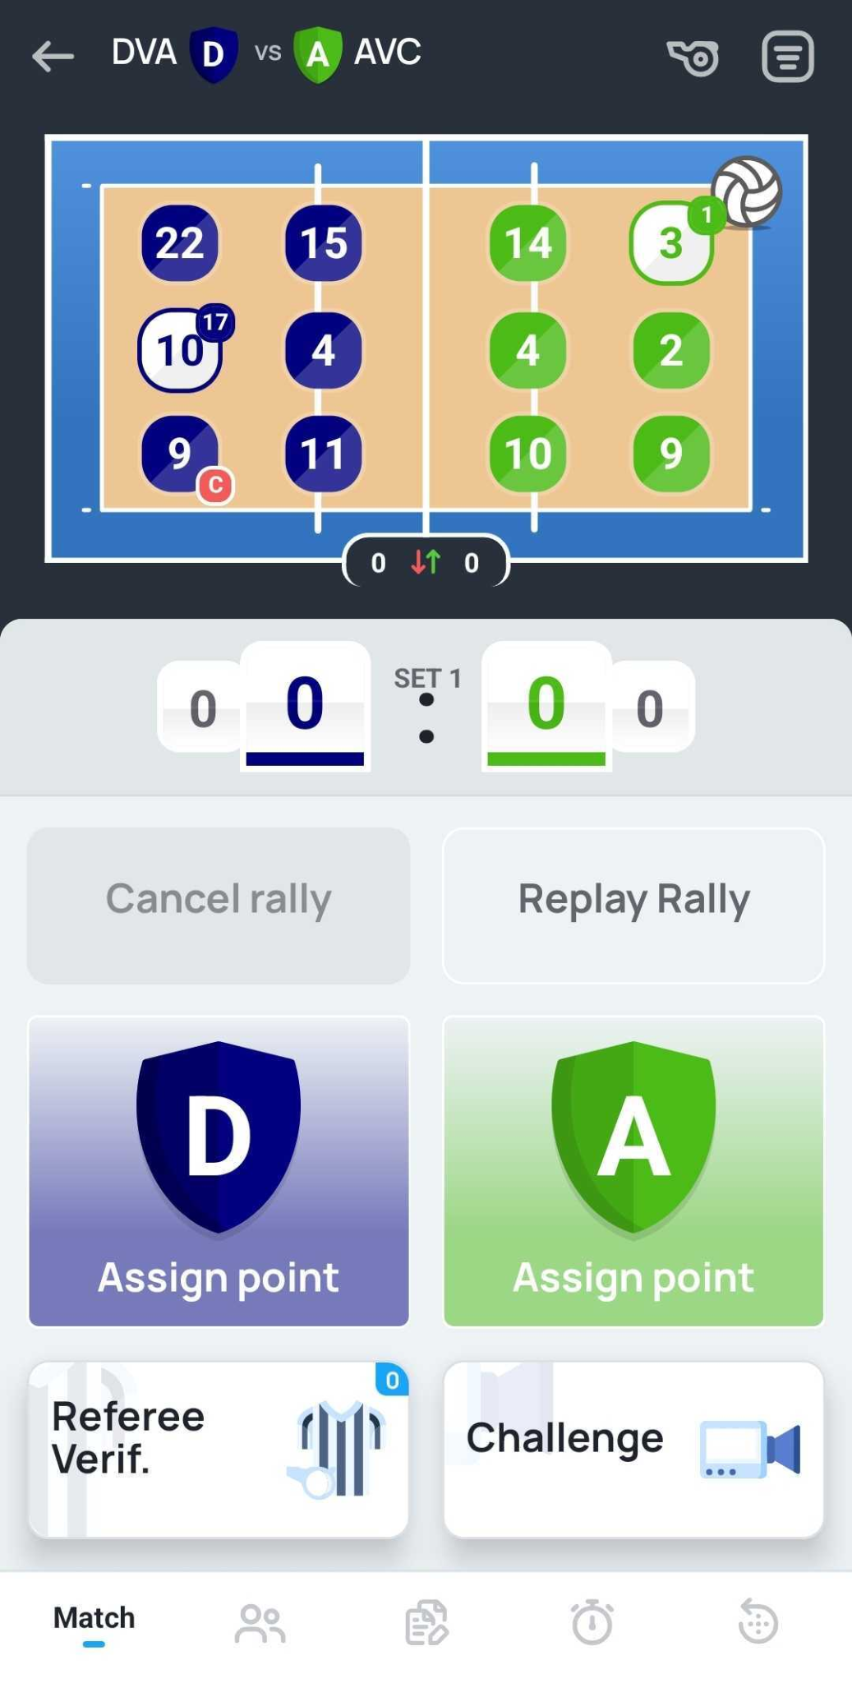
Scoring
Select “Serve” once the 1st referee blows the whistle for the first serve
Wait for the outcome of the rally and decision by the referee to assign the point to the relevant team
*After decision by the referee which team wins the point, select:
Point scoring team
The way point was scored
Attack
Block
Opponent error
Service (in case team is serving)
Relevant player if applicable

Slide 8
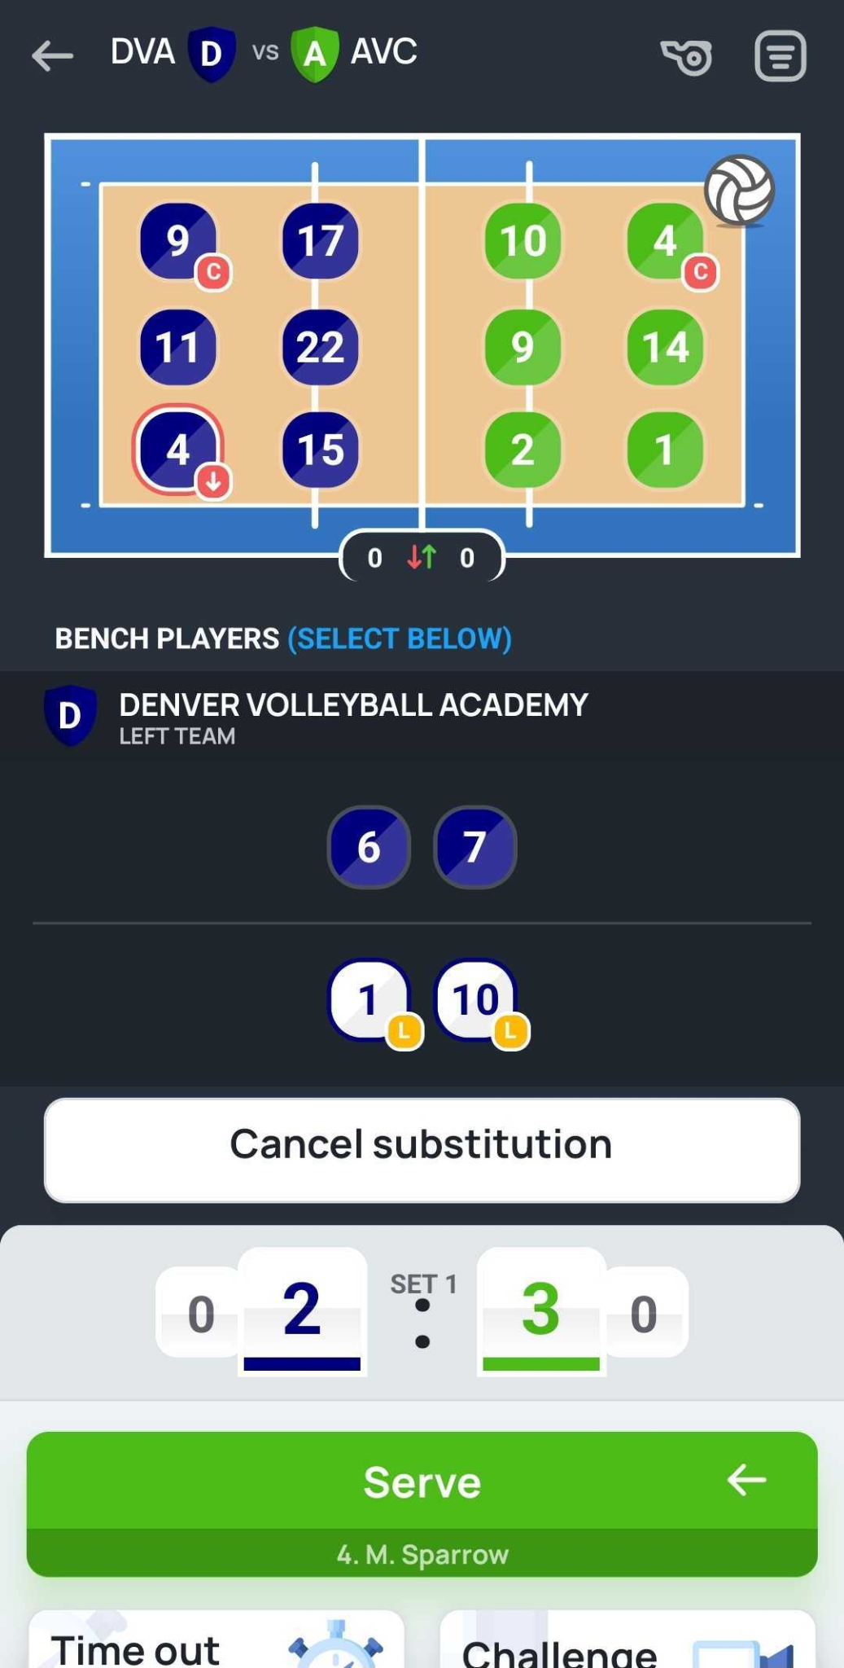

Libero in/switch
At the start of the game or at every rotation for the middle blocker to rotate further in the back line there is an option to change one of the on court players in the back line with the libero. This has to be done manually:
Select relevant libero player to change suggested player
Libero player will take this player position on court. Mini number on the top right corner will indicate player who was changed by libero

Slide 9
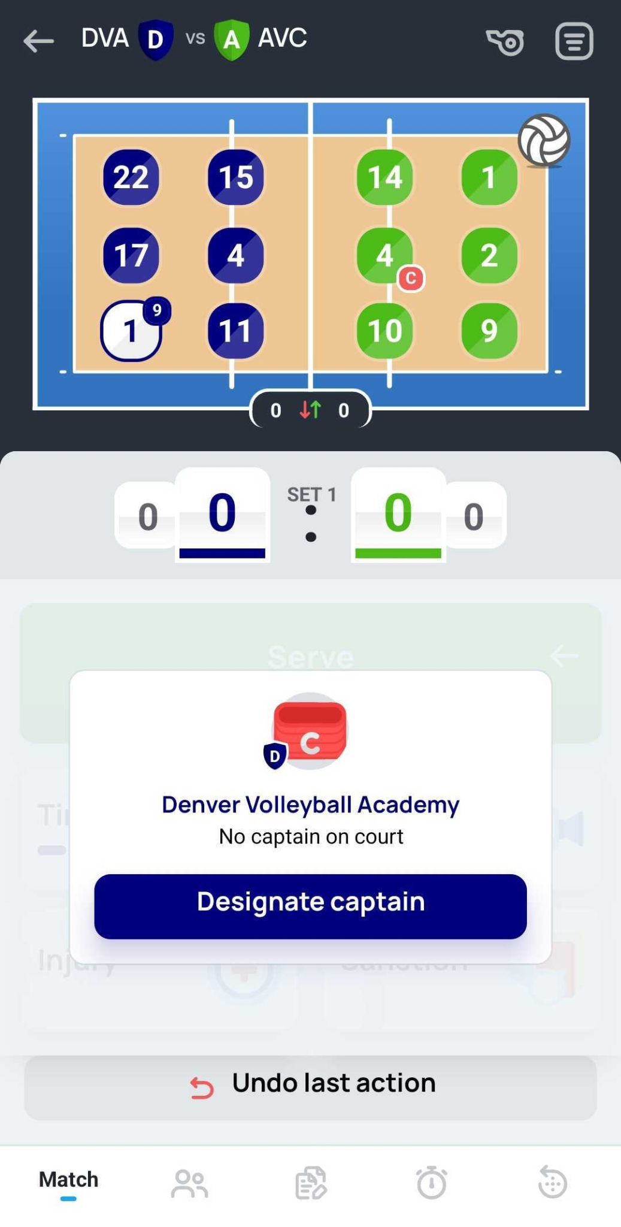
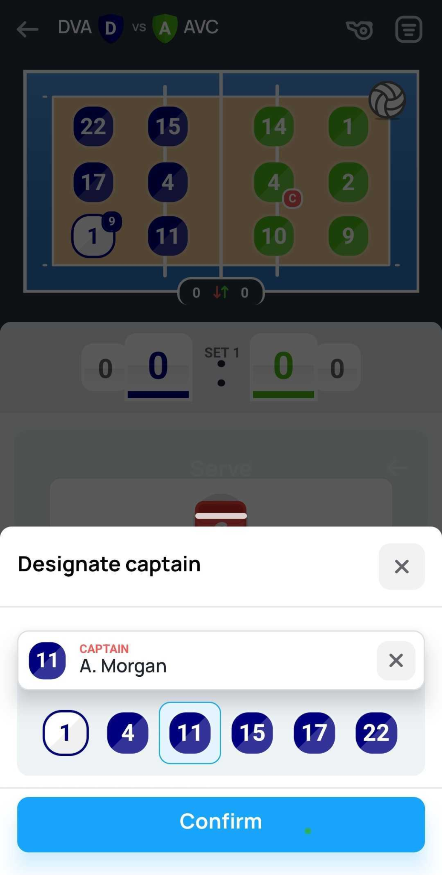
Changing the captain
In case captain is being substituted by libero or another player, new player on court should be designated as new captain:
“Designate captain” window will pop up for new selection
Select the player and confirm the selection

Slide 10
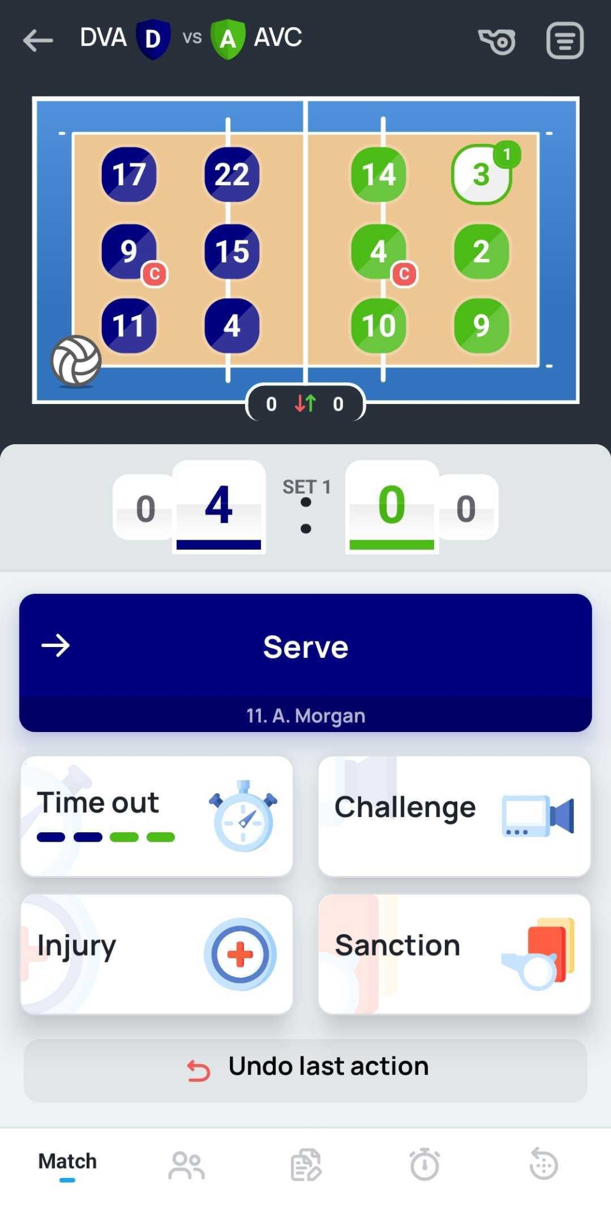
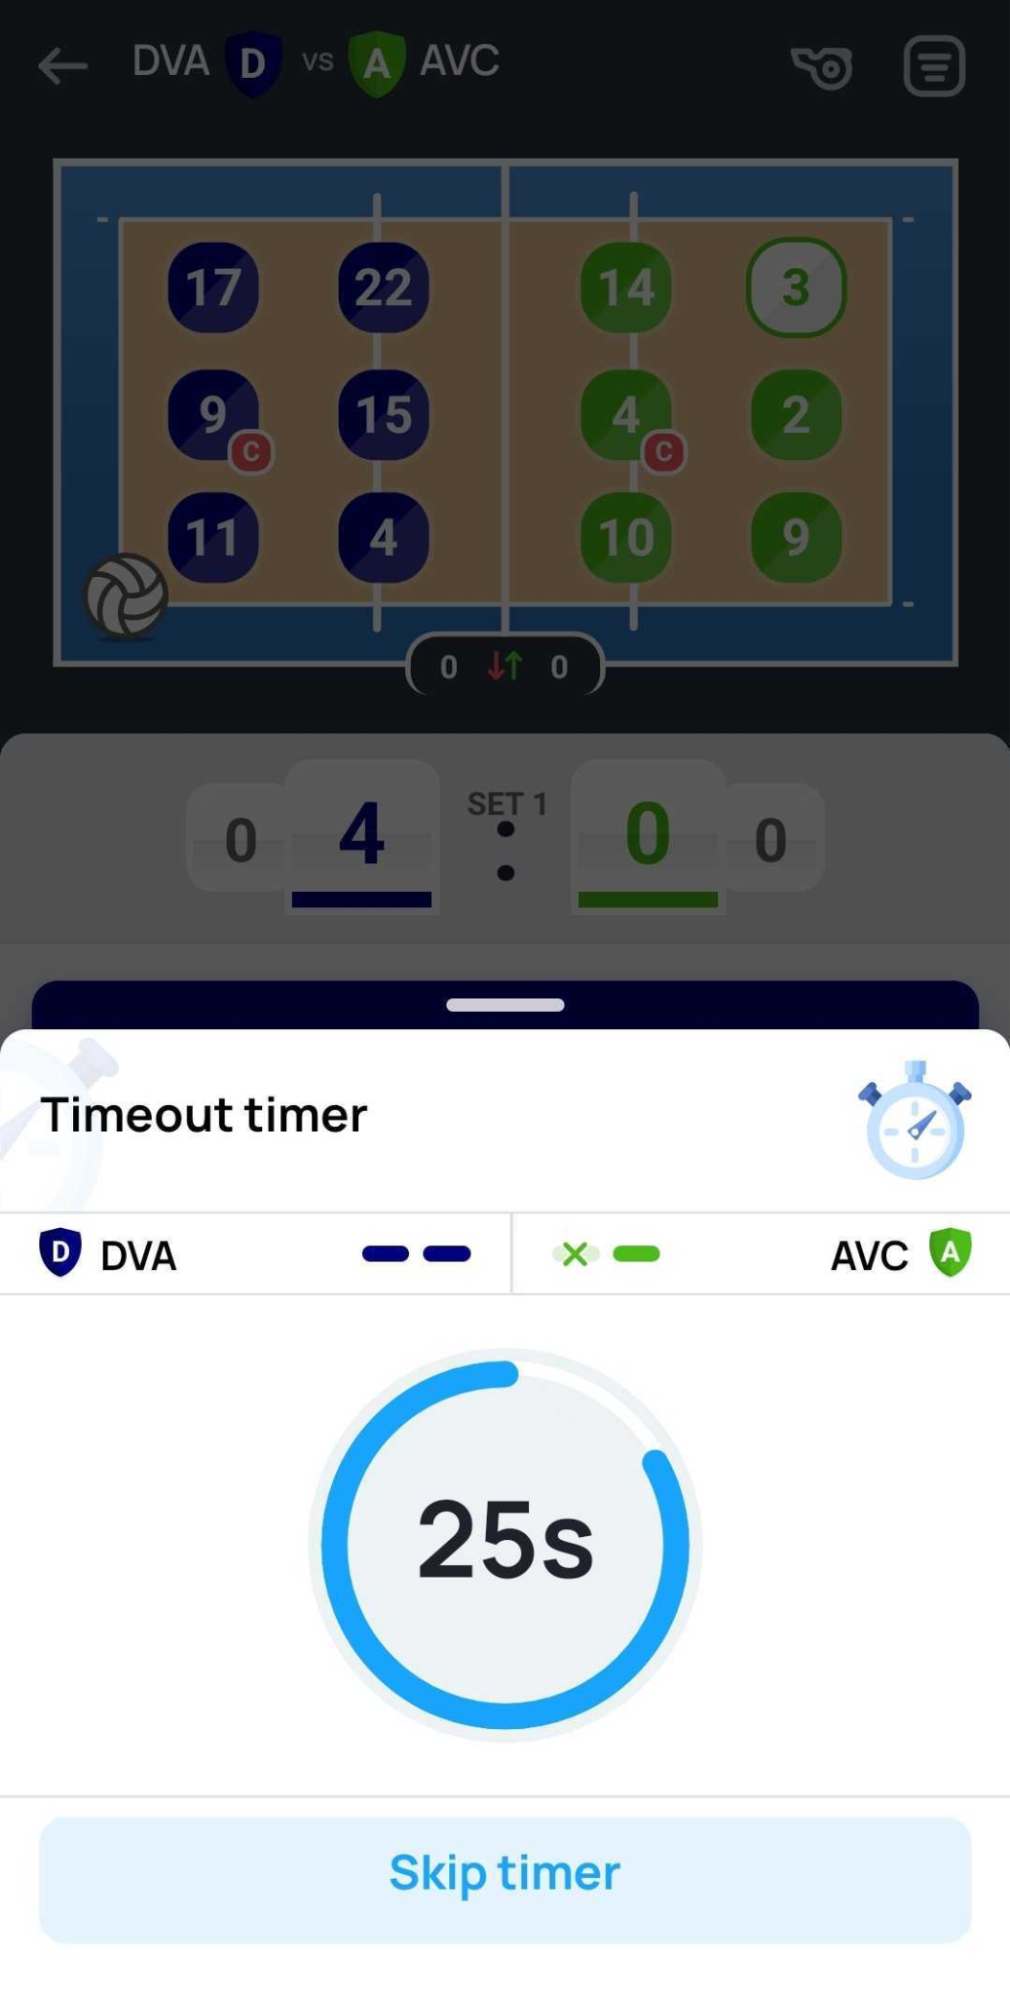

Timeout
In case of a timeout select “Timeout” and the relevant team that called it.
Once timeout is confirmed, the timer will be enabled.
Indication of the used timeout will be displayed
3
1
2

Slide 11
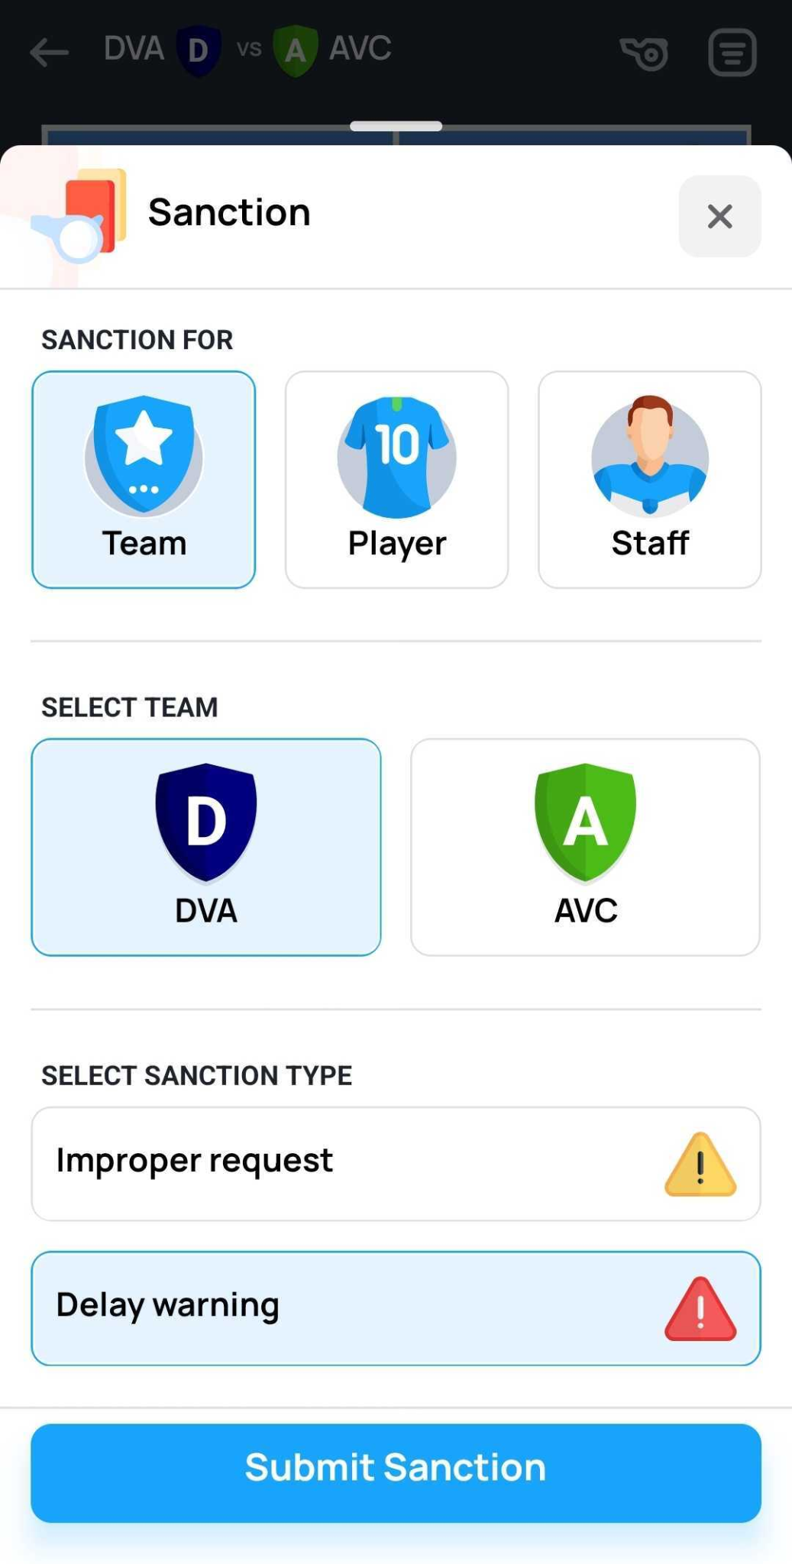
Sanction
In case of a disciplinary violation, select “Sanction” to determine relevant outcome. You will need to select:
Receiver of the sanction
Team (squad)
Player
Staff
Team (Home or Away)
Sanction type
Depending on the selected receiver of the sanction, you may need to indicate relevant person who was penalised.

Slide 12
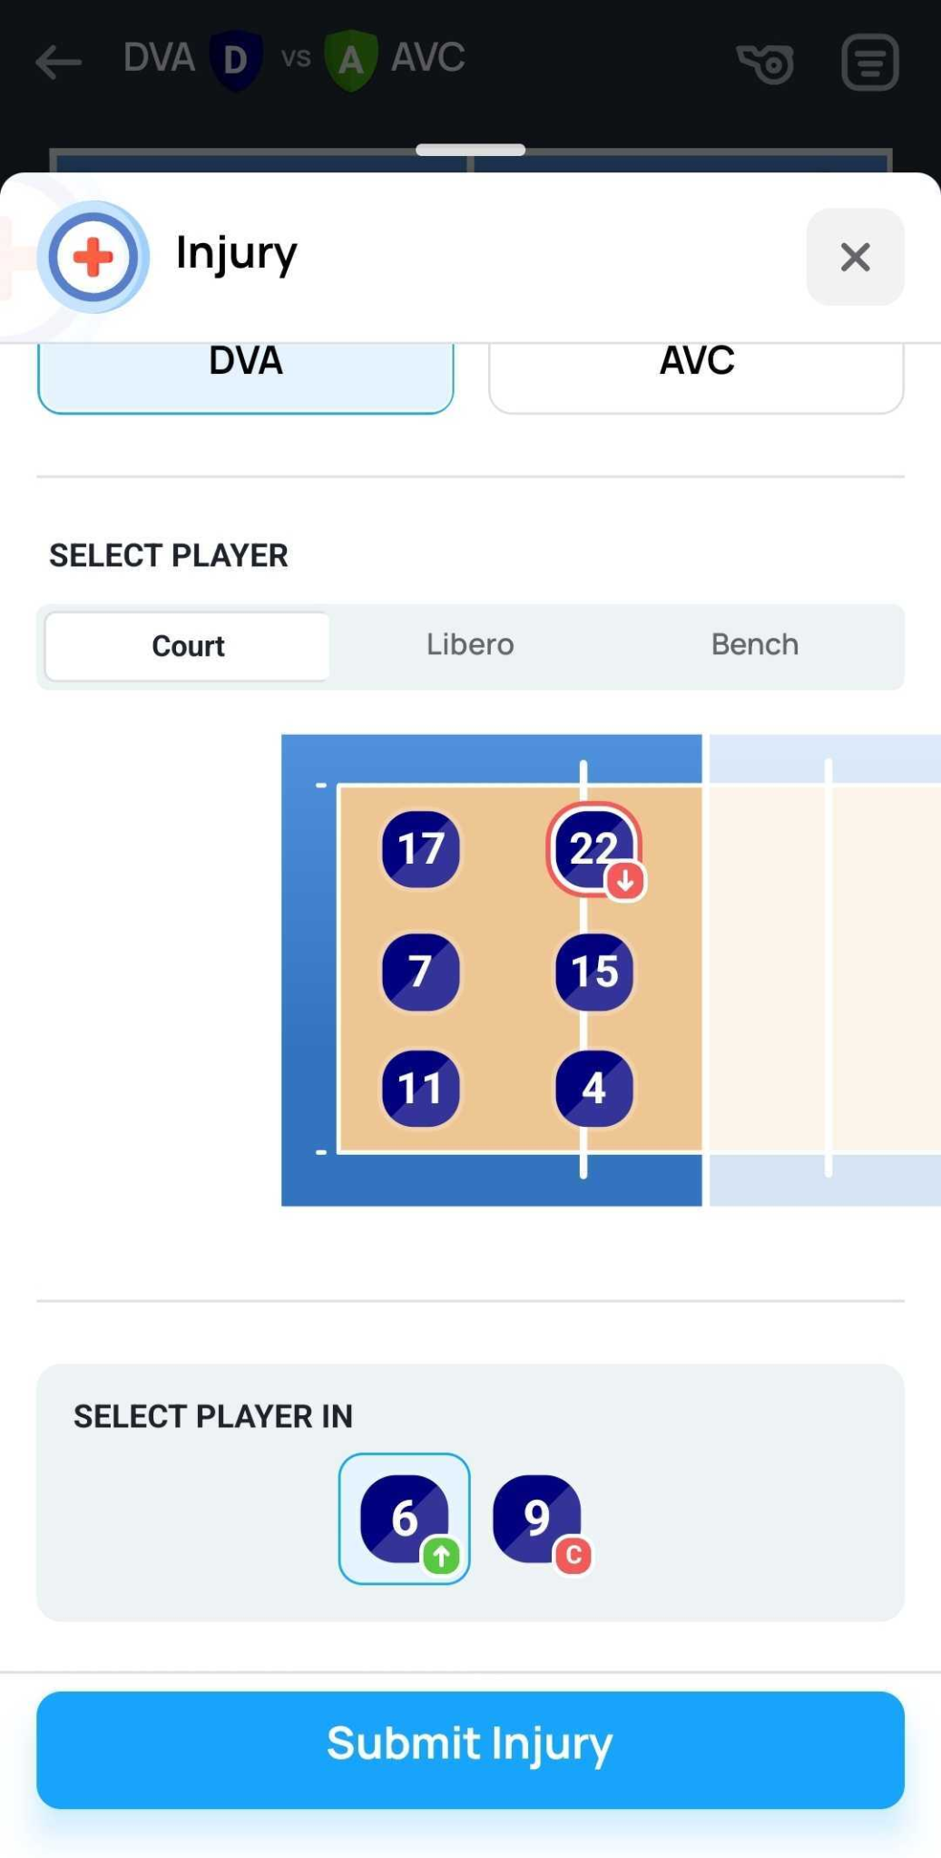
Injury
In case of a injury select “Injury” to indicate and change the player who is unable to continue to play the game. Select:
Team of an injured player
Injured player
Court
Libero
Bench
If an on court player is injured, select the player replacing him/her on the court

Slide 13
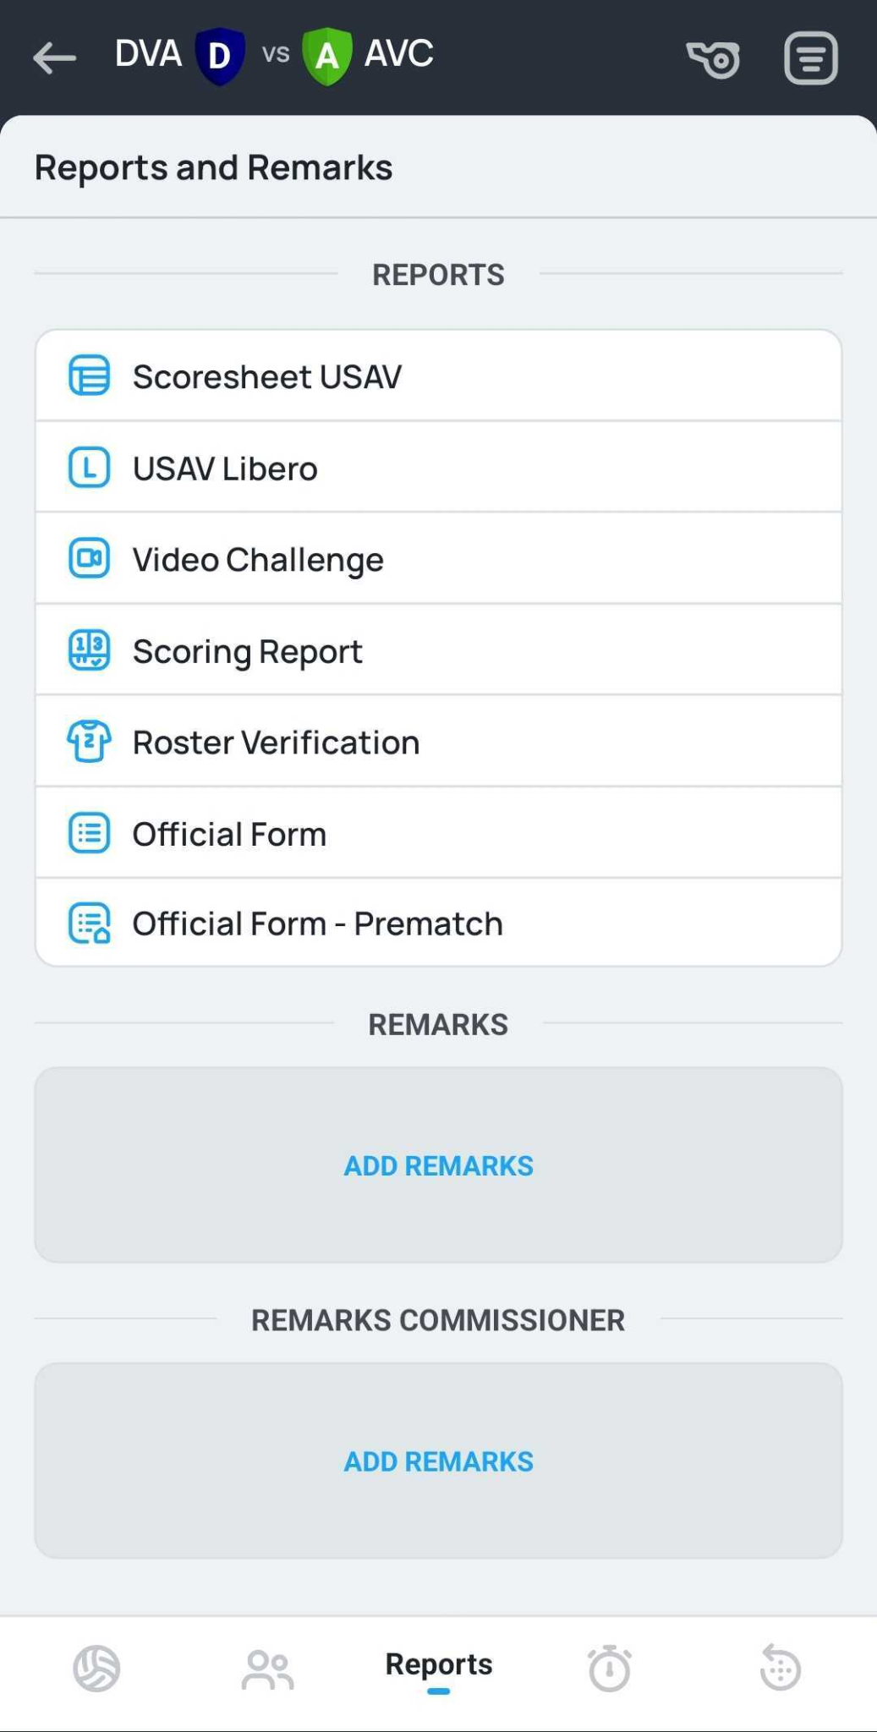
Reports and Remarks
At any point of the game in the “Reports” section, the following documents will be available:
Scoresheet USAV
USAV Libero
Video Challenge
Scoring Report
Roster Verification
Official Form
Official Form - Prematch
Additionally, any remarks for the game or commissioner remarks are entered here

Slide 14
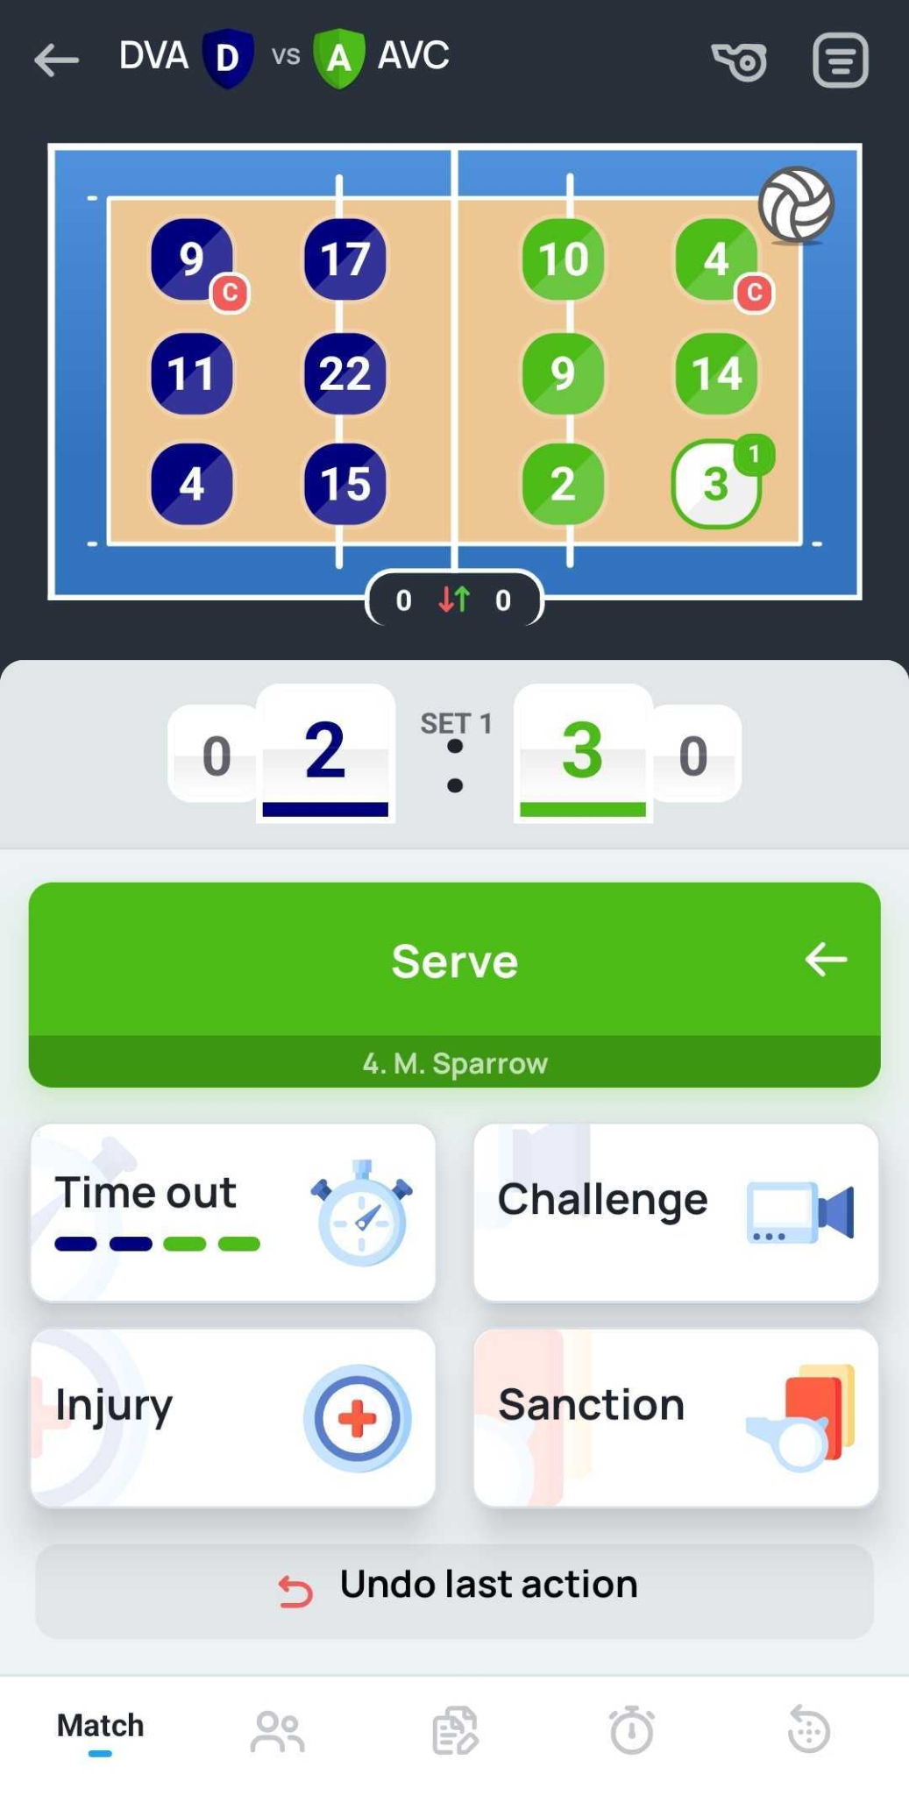
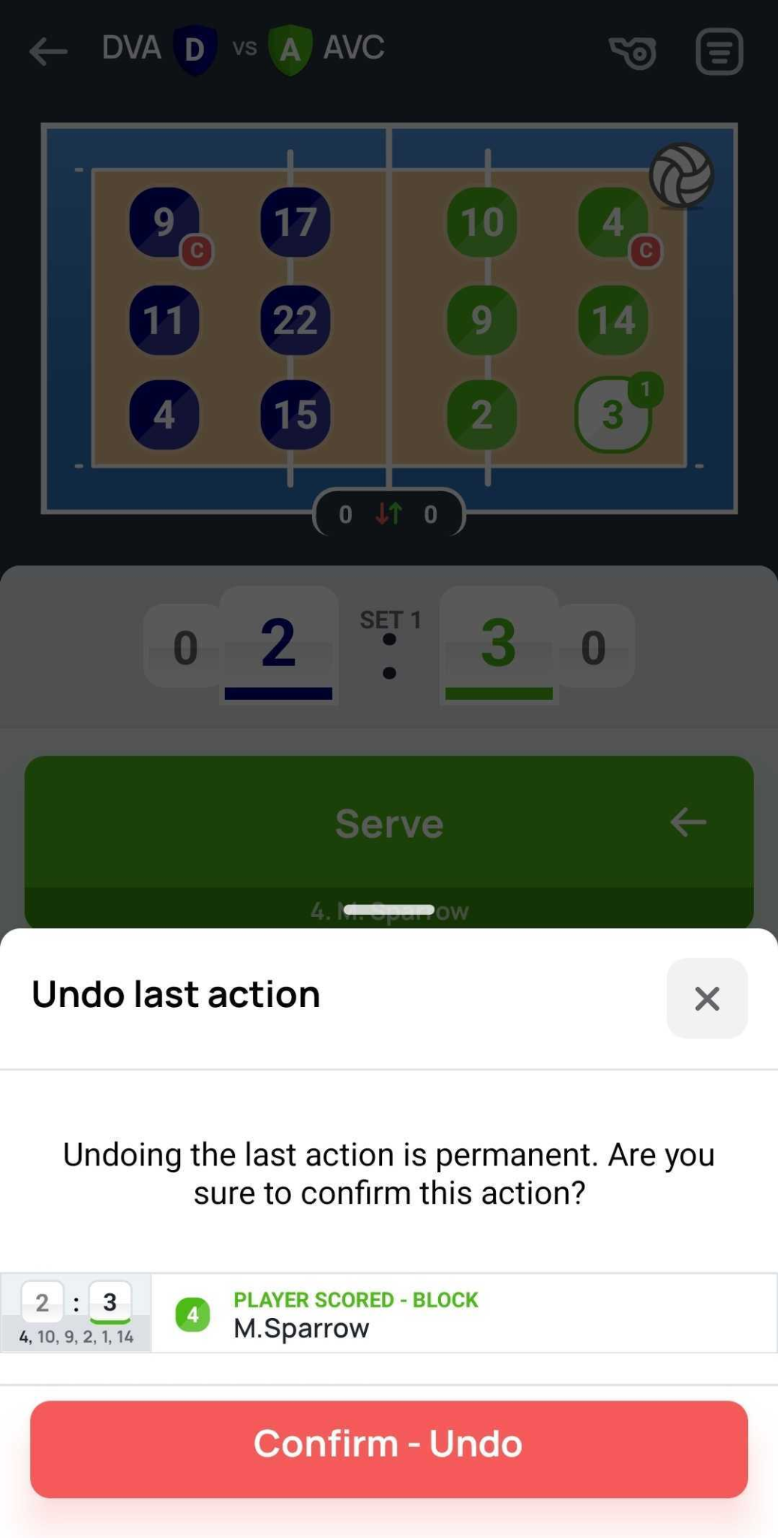
Undo the last action
In case of mistake you are able to undo several actions and repeat the sequence in the correct order.
Select “Undo last action” button. Prompt notification to confirm the undo will be requested for every action that is being removed.

Slide 15
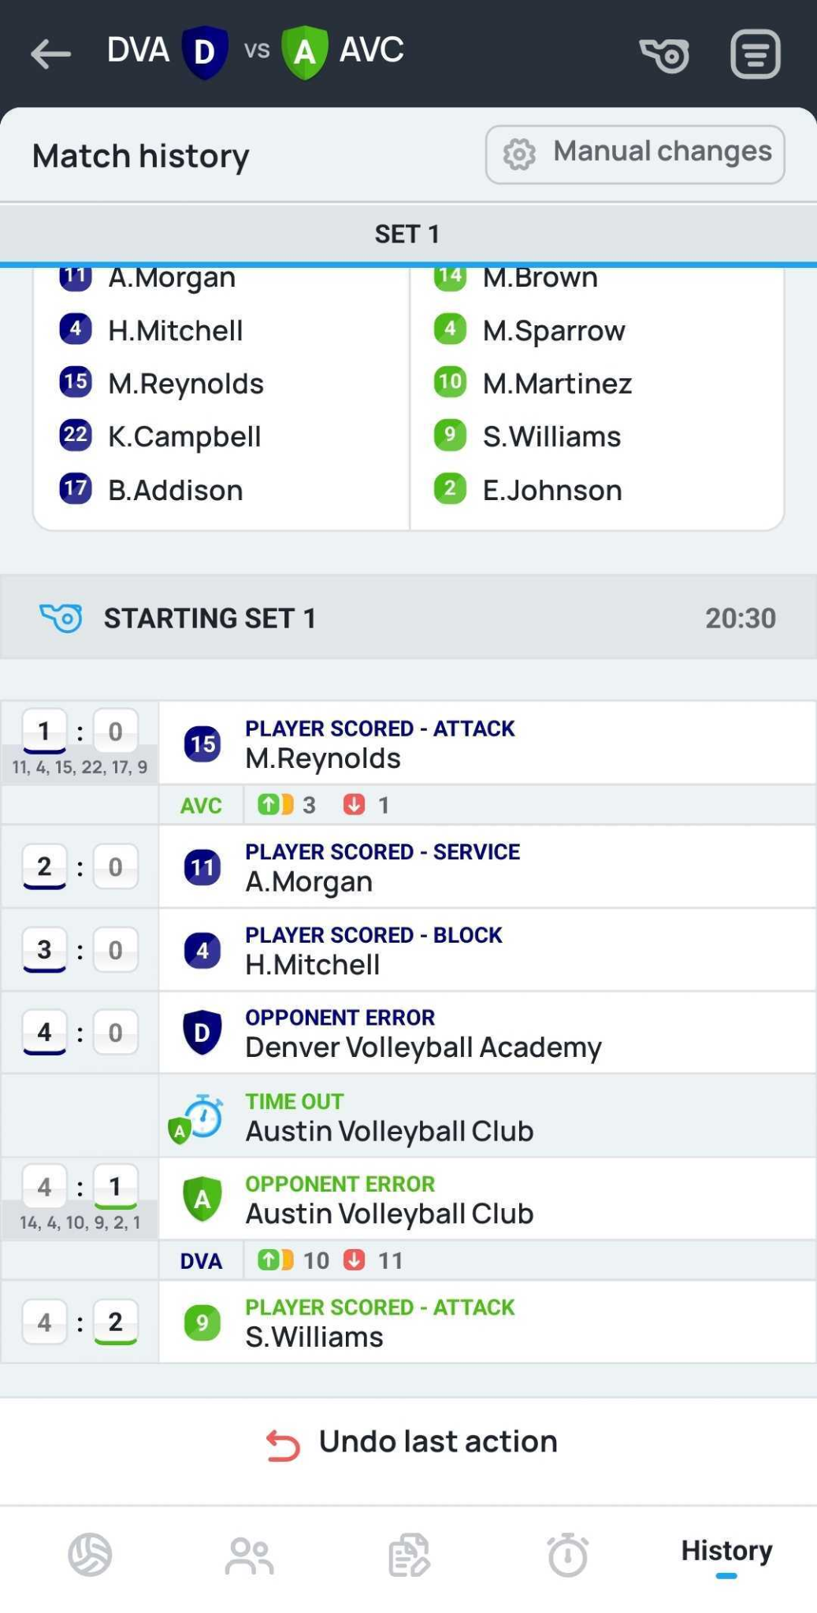
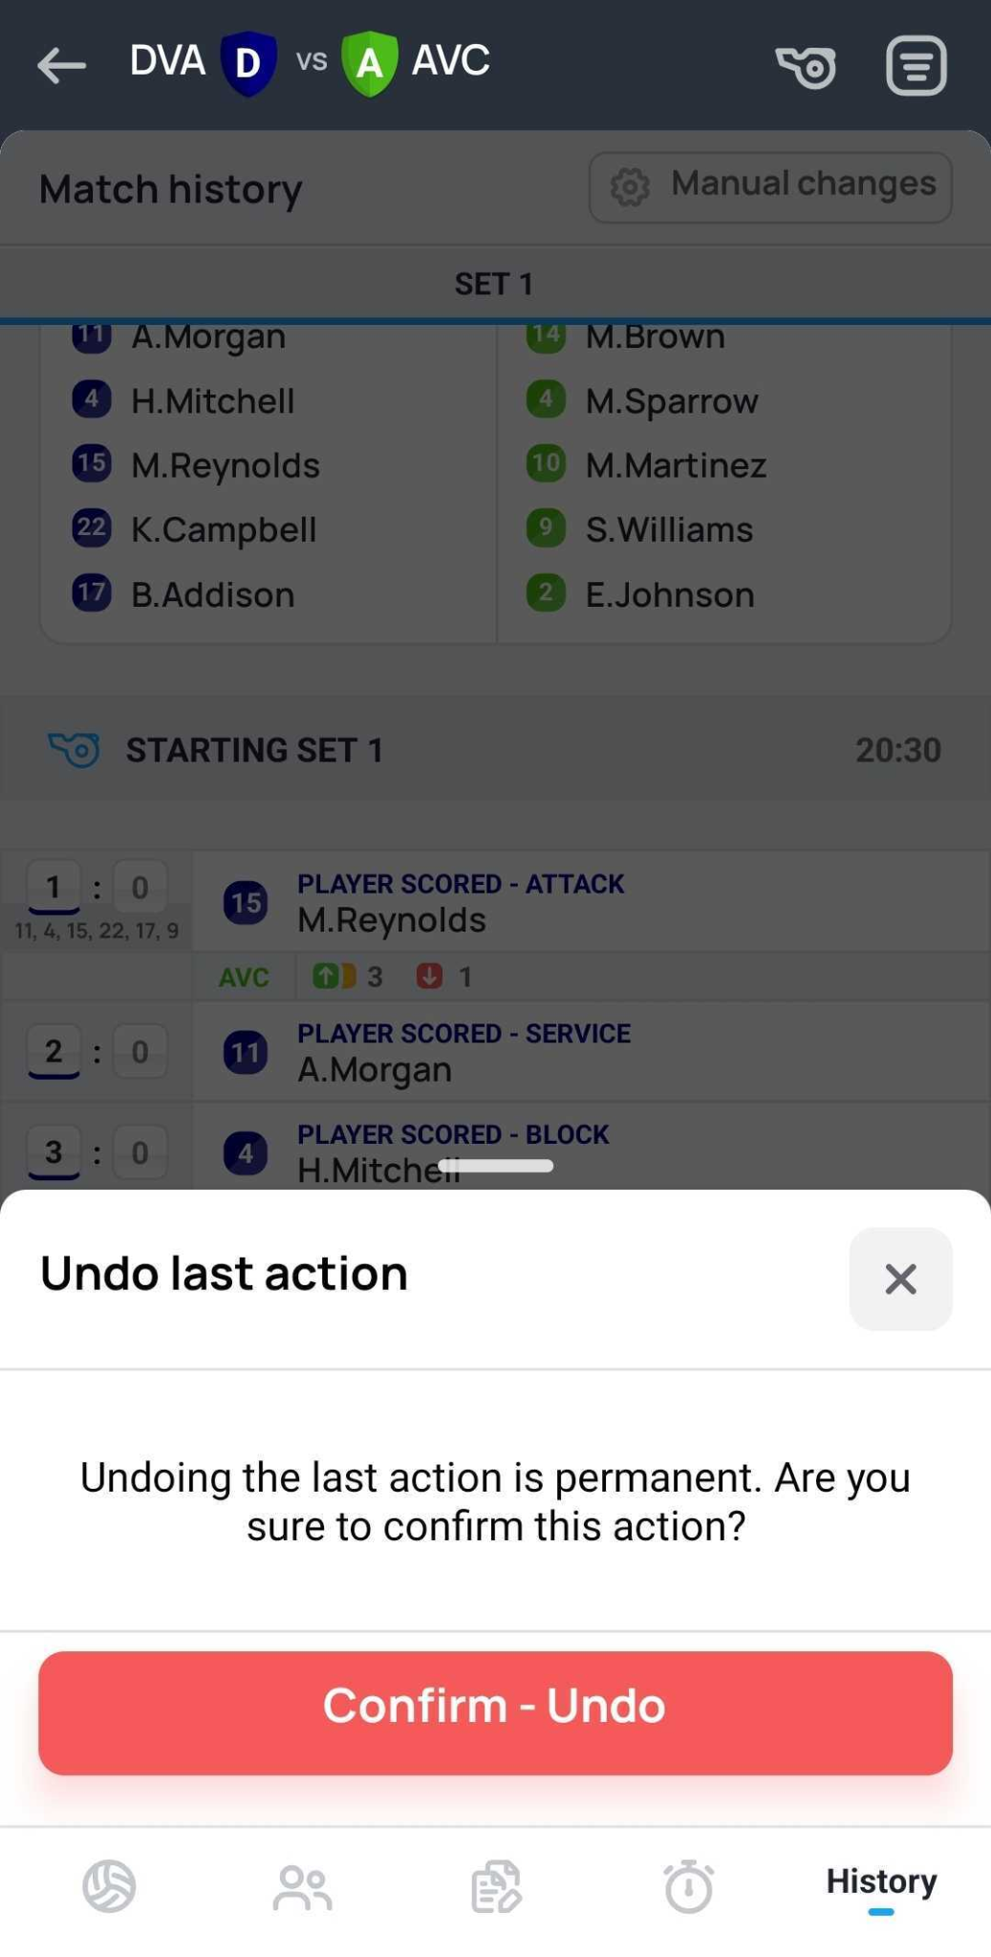
History
All the previous actions performed by the scorer will be visible under “History” tab.
Here there is another possibility to fix the mistake of incorrect sequence by pressing the “Undo last action”.

Slide 16
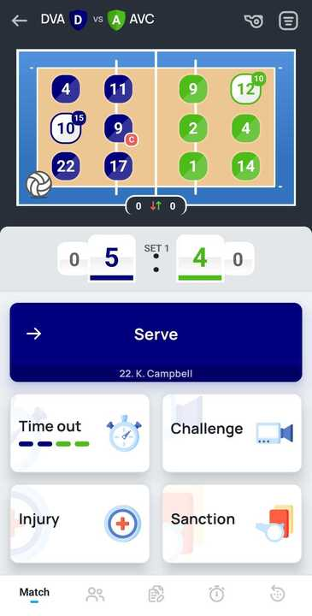
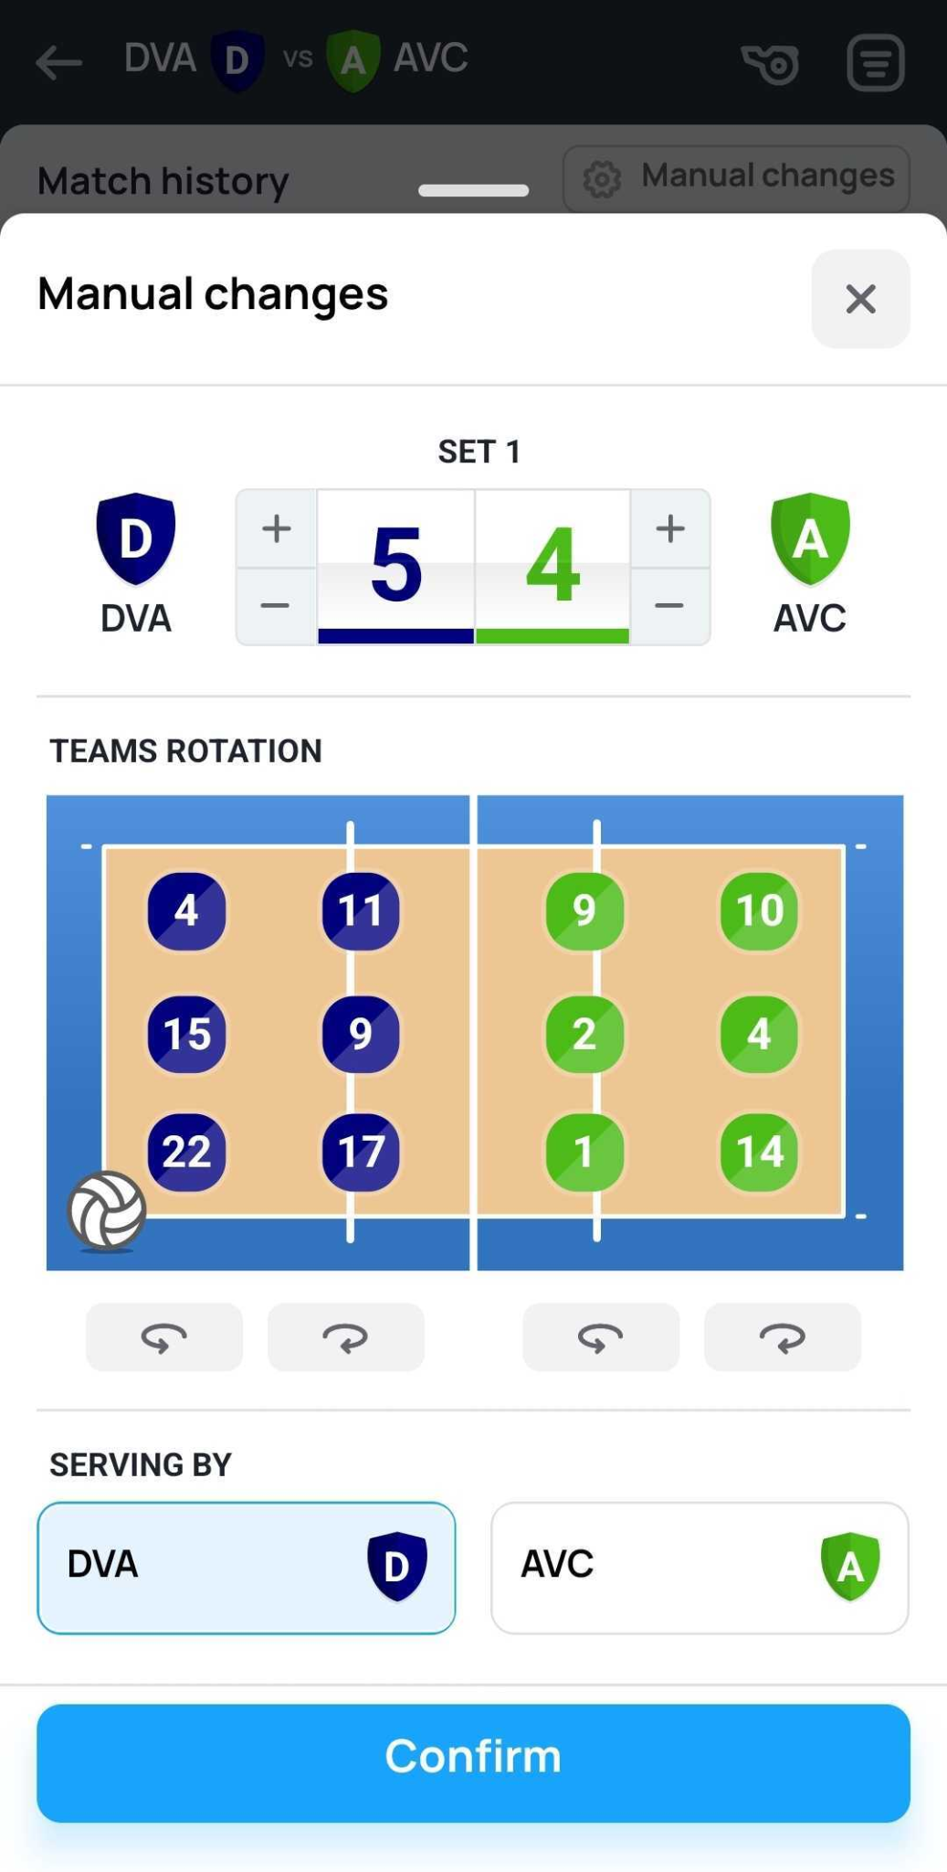
Manual changes
In case manual changes are required, you may need to perform following actions:
Press on the current score
Apply necessary changes:
Adjust the score
Change rotation
Change serving team

Slide 17
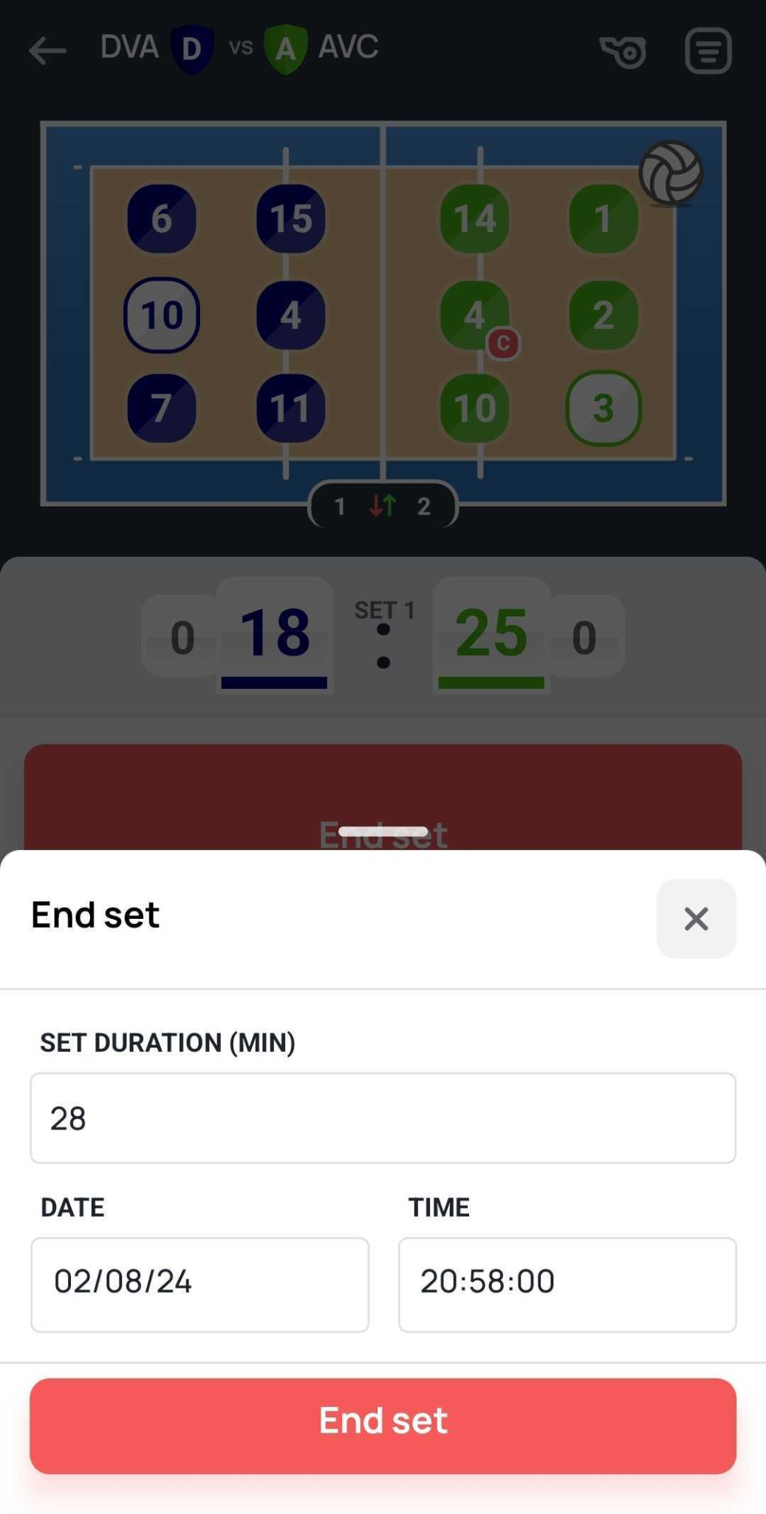
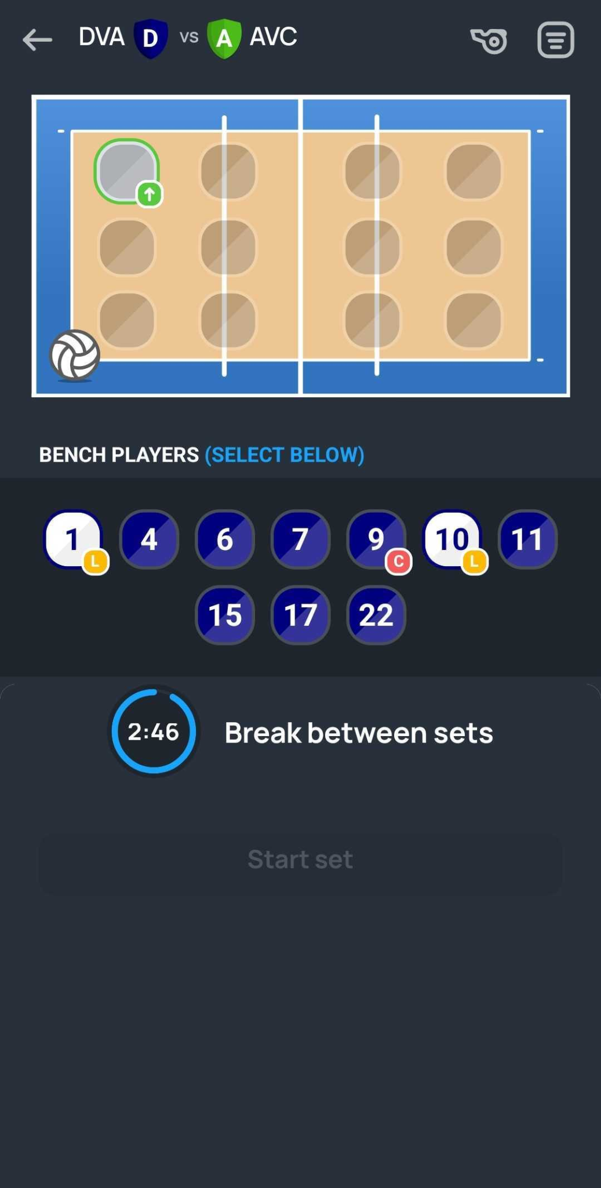
Ending the Set
At the end of the set make sure that all actions are entered correctly
Once this is done press “End set”
3 minute timer will trigger upon ending the set
Enter the starting lineups for the next set

Slide 18
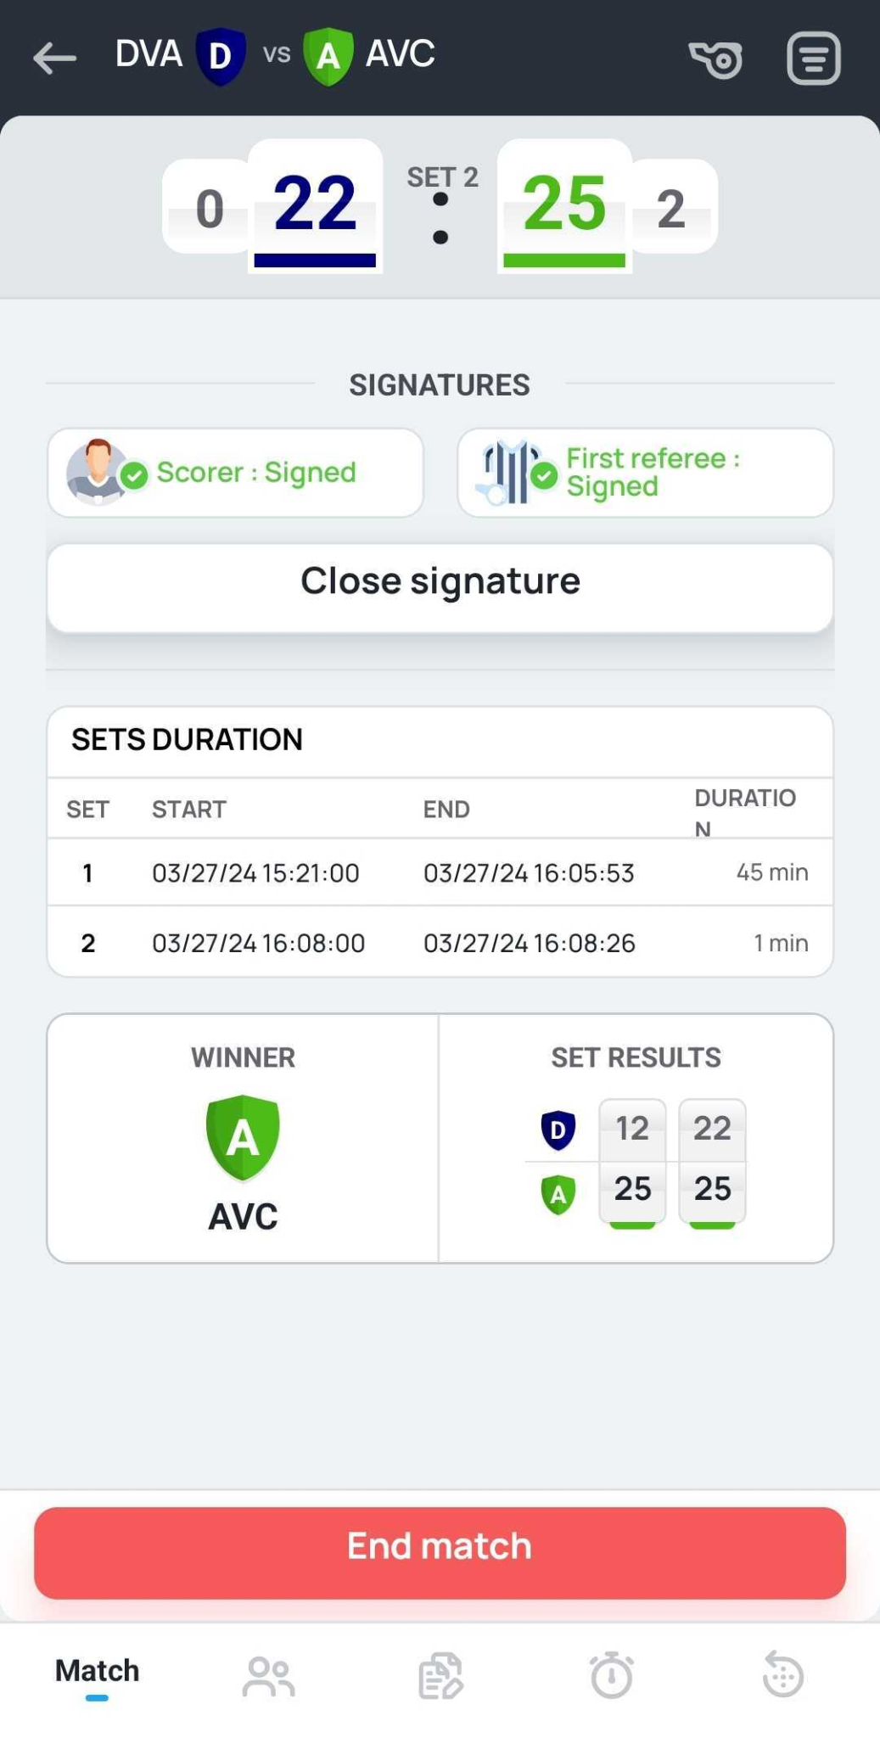
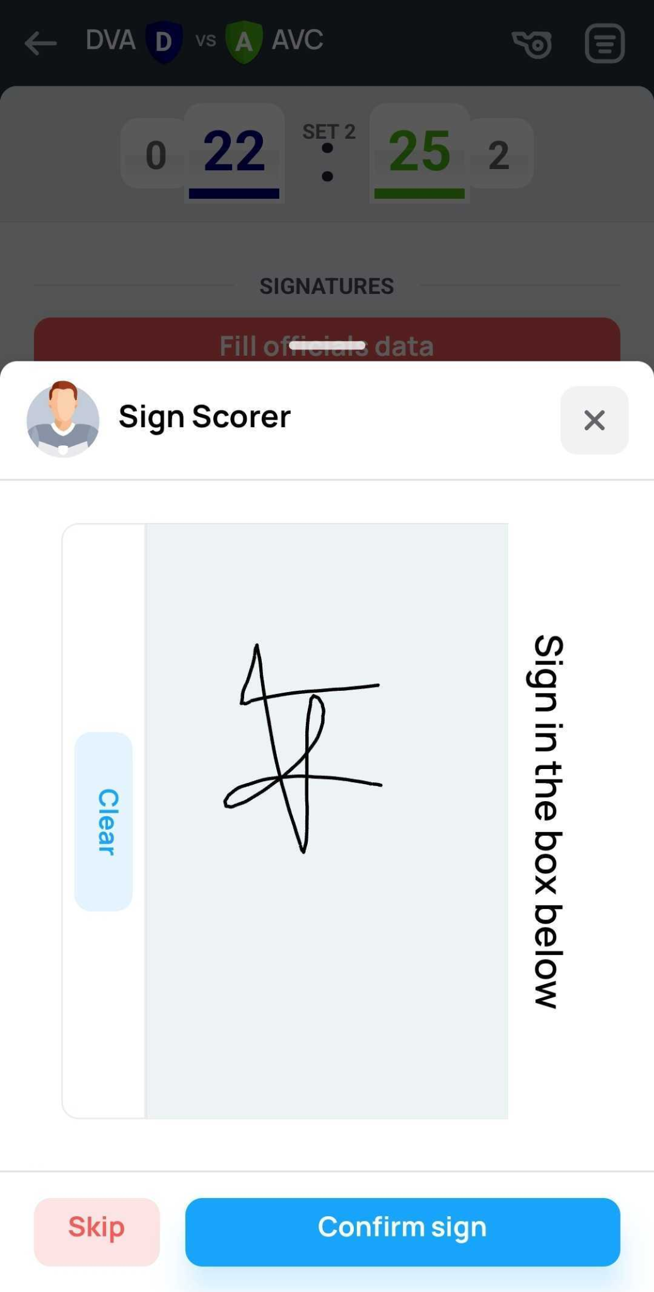
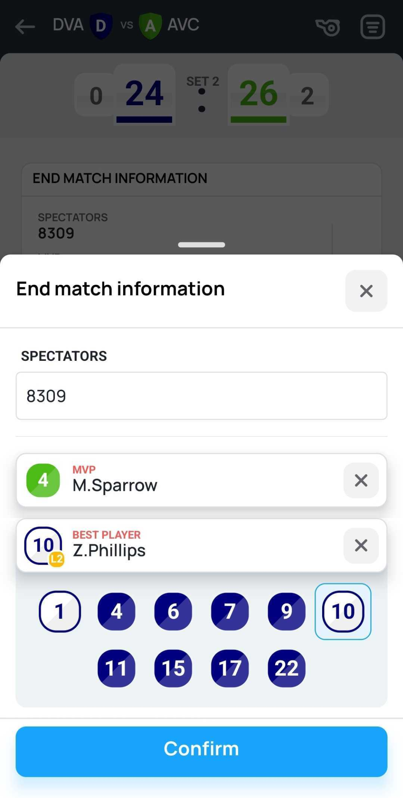
Ending the Match
At the end of the last set make sure that all actions are entered correctly.
This will allow you to enter “End match” section:
Check match information
Collect signatures from match officials
“End match” by clicking red button below. Please note that match ending is permanent, no changes will be available afterwards.
2
3
4

Slide 19
VolleyStation Score

